Slide 1
Iowa
Federal and State programs
That serve children
Vic Jaras, 21st Century Community learning Centers

Slide 2
Understanding the BIG picture
In order to help foster collaboration for children, understanding the big picture can help us see the various funding streams and they currently support children.
It is hoped that this will provide a deeper understanding of the variety of work going on in Iowa and which areas are being served.
This should help you avoid duplication of effort and perhaps supplanting with grant funds.
This information can help you to see other groups doing similar work that could be potential collaborators in the future.

Slide 3
Looking at the Data, by program and expenditure

Slide 4
Looking at the Data, by program and expenditure

Slide 5
Looking at the Data, by program and expenditure

Slide 6
Looking at the Data, by program and expenditure

Slide 7
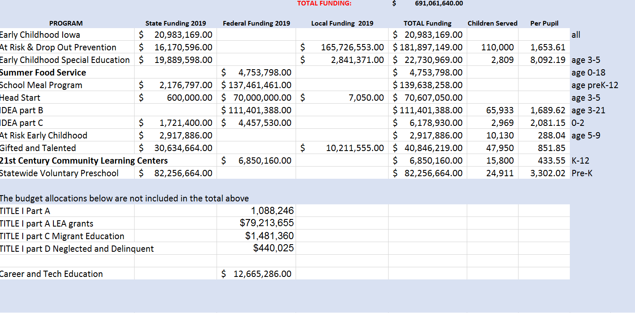
Looking at the data in a spreadsheet can provide some insight into what programs exist in Iowa and how they serve children

Slide 8
Note: The 2020 Estimated budget
Funds for State Formula-Allocated and Selected Student Aid Programs
U.S. Department of Education Funding
Iowa
 |  |  |  | Amount Change | Percent Change
Program | 2018 Actual | 2019 Estimate | 2020 Estimate | FY 2019 to 2020 | FY 2019 to 2020
Grants to Local Educational Agencies | 97,622,846 | 88,080,422 | 86,311,932 | -1,768,490 | -2.0%
State Agency Program--Migrant | 1,729,735 | 2,096,670 | 2,241,566 | 144,896 | 6.9%
State Agency Program--Neglected and Delinquent | 407,810 | 512,924 | 512,924 | 0 | 0.0%
Subtotal, Education for the Disadvantaged | 99,760,391 | 90,690,016 | 89,066,422 | -1,623,594 | -1.8%
Impact Aid Basic Support Payments | 150,965 | 172,319 | 172,834 | 515 | 0.3%
Impact Aid Payments for Children with Disabilities | 23,583 | 27,299 | 27,299 | 0 | 0.0%
Impact Aid Construction | 0 | 0 | 0 | 0 | ---
Subtotal, Impact Aid | 174,548 | 199,618 | 200,133 | 515 | 0.3%
Supporting Effective Instruction State Grants | 15,794,406 | 15,087,758 | 0 | -15,087,758 | -100.0%
21st Century Community Learning Centers | 7,300,582 | 7,290,323 | 0 | -7,290,323 | -100.0%
State Assessments | 5,058,166 | 5,063,039 | 5,063,039 | 0 | 0.0%
Rural and Low-income Schools Program | 537,414 | 537,414 | 537,414 | 0 | 0.0%
Small, Rural School Achievement Program | 3,501,649 | 3,501,649 | 3,501,649 | 0 | 0.0%
Student Support and Academic Enrichment State Grants | 6,675,428 | 7,023,963 | 0 | -7,023,963 | -100.0%
Safe Schools and Citizenship Education | 0 | 0 | 944,098
Indian Education--Grants to Local Educational Agencies | 287,161 | 276,748 | 276,748 | 0 | 0.0%
English Language Acquisition | 4,167,314 | 4,112,558 | 4,112,558 | 0 | 0.0%
Homeless Children and Youth Education | 517,529 | 492,579 | 492,579 | 0 | 0.0%
Subtotal | 143,774,588 | 134,275,665 | 104,194,640 | -30,081,025 | -22.4%
Special Education--Grants to States | 128,160,856 | 128,973,897 | 128,973,897 | 0 | 0
Special Education--Preschool Grants | 3,997,995 | 4,092,406 | 4,092,406 | 0 | 0.0%
Grants for Infants and Families | 4,457,530 | 4,422,987 | 4,422,987 | 0 | 0.0%
Subtotal, Special Education | 136,616,381 | 137,489,290 | 137,489,290 | 0 | 0.0%
Career and Technical Education State Grants | 11,963,946 | 12,665,286 | 12,665,286 | 0 | 0
Subtotal, Vocational and Adult Education | 11,963,946 | 12,665,286 | 12,665,286 | 0 | 0.0%
Subtotal, All Elementary/Secondary Level Programs | 292,354,915 | 284,430,241 | 254,349,216 | -30,081,025 | -10.6%

Slide 9
TITLE FUND TRANSFERS
Federal transferability of funds is governed by Title V in Every Student Succeeds Act (ESSA) Section 5102. An LEA may transfer Title II, Part A and Title IV, Part A program funds to other allowable programs.
Guidance
Federal transferability of funds is governed by Title V in ESSA Section 5102. An LEA may transfer Title II, Part A and Title IV, Part A program funds to other allowable programs. This transferability is not the same as Title V Subpart 1 Rural Education Achievement Program Flexibility (REAP-Flex) governed by Elementary and Secondary Education Act (ESEA) Section 5211. Funds transferred under REAP-Flex are not to be included on this form.
Regardless of transfers, the LEA will continue to be responsible for meeting Title II, Part A and Title IV, Part A legal requirements, which are required as a condition of accepting the funds. In addition, funds transferred to other allowable programs are subject to the legal requirements for those programs.

Slide 10
Why is transferability important?
Transferability provides SEAs and LEAs with unprecedented flexibility in targeting Federal resources to meet the needs of all children. It can be a powerful tool in assisting States and districts in pursuing their own strategies for raising student achievement. It facilitates the development and implementation of integrated approaches for addressing local educational needs and priorit
An LEA (except an LEA identified for improvement under 1116(c) or subject to corrective action under section 1116(c)(9)) may transfer up to 50 percent of the funds allocated to it by formula under certain provisions identified in the statute.
An LEA identified for improvement under section 1116(c) may transfer not more than 30 percent of the funds allocated to it by formula under the provisions identified in the statute to its allocation for school improvement under section 1003 or to any other allocation listed in the statute if the transferred funds are used only for LEA improvement activities consistent with section 1116(c). The LEA may not transfer funds allocated under Part A of Title I to any other program.
An LEA identified for corrective action is prohibited from transferring funds under the transferability authority.

Slide 11
Transfer of funds
II-B-1. What is REAP-Flex?
“REAP-Flex” is the term that the U.S. Department of Education has given to the “alternative uses of funds” authority under the Small, Rural School Achievement program. This authority provides flexibility to eligible rural LEAs (see discussion in II-A-3) to use specific Federal formula funds (i.e., each LEA’s “applicable funding”) to support local activities under an array of Federal programs in order to assist them in addressing local academic needs more effectively. (See section 6211 of the ESEA.)
REAP-Flex does not involve a transfer of funds from one program to another. Rather, REAP-Flex gives an LEA broader authority in spending “applicable funding” for alternative uses under selected federal programs. On the other hand, when an LEA transfers funds from one program to another under the transferability authority in section 6123, the transferred funds increase the allocation of the receiving program and are subject to all of the rules and requirements of the receiving program. (See Appendix B.)

Slide 12
Transfer of funds
II-B-2. What is “applicable funding?”
“Applicable funding” is the funding for which an eligible LEA may exercise its REAP-Flex authority. Specifically, “applicable funding” includes all funds allocated by formula to an eligible LEA under the following programs:
Subpart 2 of Part A of Title II (Improving Teacher Quality State Grants);
Part D of Title II (Educational Technology State Grants);
Part A of Title IV (Safe and Drug-Free Schools and Communities); and
Part A of Title V (State Grants for Innovative Programs).
NOTE: In order to receive its funds under one of the above-listed programs, an LEA must meet the relevant application and eligibility requirements, regardless of whether it intends to use the funds for alternative uses under the REAP-Flex authority. For example, an LEA must have a technology plan that meets the requirements of Part D of Title II in order to receive its allocation under that program, even if it intends to use all of that allocation for another purpose authorized under the REAP-Flex legislation.

Slide 13
Transfer of funds
II-B-3. For what purposes may an LEA with REAP-Flex authority use its “applicable funding”?
An LEA with REAP-Flex authority may use all or part of its “applicable funding” for local activities authorized under one or more of the following ESEA programs:
Part A of Title I (Improving the Academic Achievement of the Disadvantaged);
Part A of Title II (Improving Teacher Quality State Grants);
Part D of Title II (Educational Technology State Grants);
Title III (Language Instruction for Limited English Proficient and Immigrant Students);
Part A of Title IV (Safe and Drug-Free Schools and Communities);
Part B of Title IV (21st Century Community Learning Centers); and
Part A of Title V (State Grants for Innovative Programs).
(Note: The list of ESEA programs under which an LEA is authorized to conduct REAP-Flex activities is more extensive than the sources from which an LEA’s “applicable funding” is derived. (Compare II-B-3 with II-B-2.) An LEA may also use SRSA grant funds for authorized local activities under the same seven programs listed above. (See II-D-1.))
Additional information on these programs is available on the Department’s web site at www.ed.gov.

Slide 14
Transfer of funds
II-B-4. Does an eligible LEA need the approval of its SEA or the U.S. Department of Education before exercising REAP-Flex authority?
No. An LEA that meets the eligibility requirements of the SRSA program may exercise REAP-Flex authority without the approval of either its SEA or the U.S. Department of Education. However, before exercising REAP-Flex authority, an eligible LEA must annually notify its SEA of its intent to do so by the notification deadline established by the SEA.

