Slide 1
Data Collection and Entry: What to Collect, How to Collect, and When to Collect
APR, Local Evaluation and Annual State Survey – November 19, 2020

Slide 2
Why we collect data
21CCLC is a data heavy funding source – and for good reason. Nationally, there is over $1.2 billion distributed to states to secure bright futures for youth.
In Iowa we have $5.5 million to allocate in FY21 which is divided amongst the current grantees and new applications.
The data we collect is used to better tell our story which includes:
17,073 youth served, but only 7336 youth “paid for” by grant funds meaning those other 9737 youth served through community partnerships connected to the program.
49 grants to 21 sites serving 103 buildings across the state
59% of youth served receive Free/Reduced Price Lunch (compared to a state average of 41%)
Notes:
Add code section – last one in email sent 11/9

Slide 3
When is my data due?
As a first year grantee, your timeline is behind one year. This means:
APR Data
Summer 2019 – entered in the spring of 2020 – SHOULD BE ENTERED
Fall 2019 – WINDOW IS OPEN October 27, 2020 – December 21, 2020
Spring of 2020 – WINDOW WILL OPEN December 22, 2020 – February 15, 2021
Summer 2020 – entered in the spring of 2021
Fall 2020 – to be entered next year
Spring 2021 – to be entered next year
Local Evaluation Data
Due on November 30, 2020. However, extensions can be granted for those in need.
Statewide Survey Data
Open on November 16, 2020 and will be due January 15, 2021

Slide 4
APR (Annual Performance Report)
The APR is the Federal Reporting System REQUIRED by the government.
Data is inputted three times per year.
You must create a log in and update your password every 60 days.
Notes:
Report goes to Congress 3x per year

Slide 5
Info from Tim
How to create an account and maintain your password
The 21CCLC Committees have put together a basic Excel spreadsheet that can act as a guide for the type of data you’ll be expected to collect can be found here under the Evaluation Services section here: https://www.iowa21cclc.com/grant-info.
Our recommendation is to update this information on a regular basis – monthly, quarterly, etc. You’ll want to decide what is best.
Slide examples from screens- matched with template
How to access TA
How to print your screens

Slide 6
Login Credentials
You will receive a password to 21APR before the Summer reporting period opens.
If you need new login credentials contact Tim Glenn at Tim.Glenn@iowa.gov
If you forget your password there is a link on the sign-in page of the website.

Slide 7
Logging in for the first time https://21apr.ed.gov/login

Slide 8
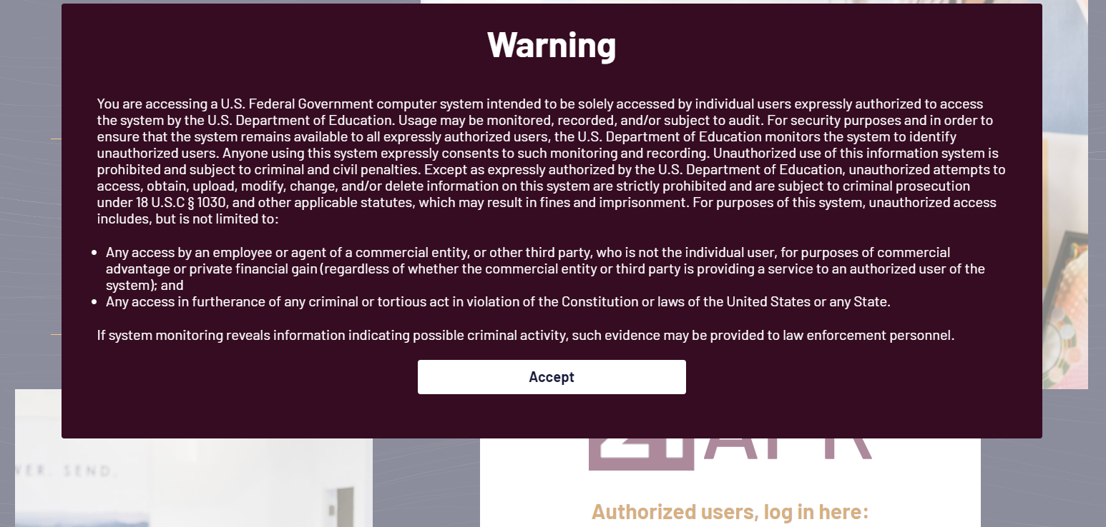
Notes:
You must click the “Accept” button to access the login screen

Slide 9
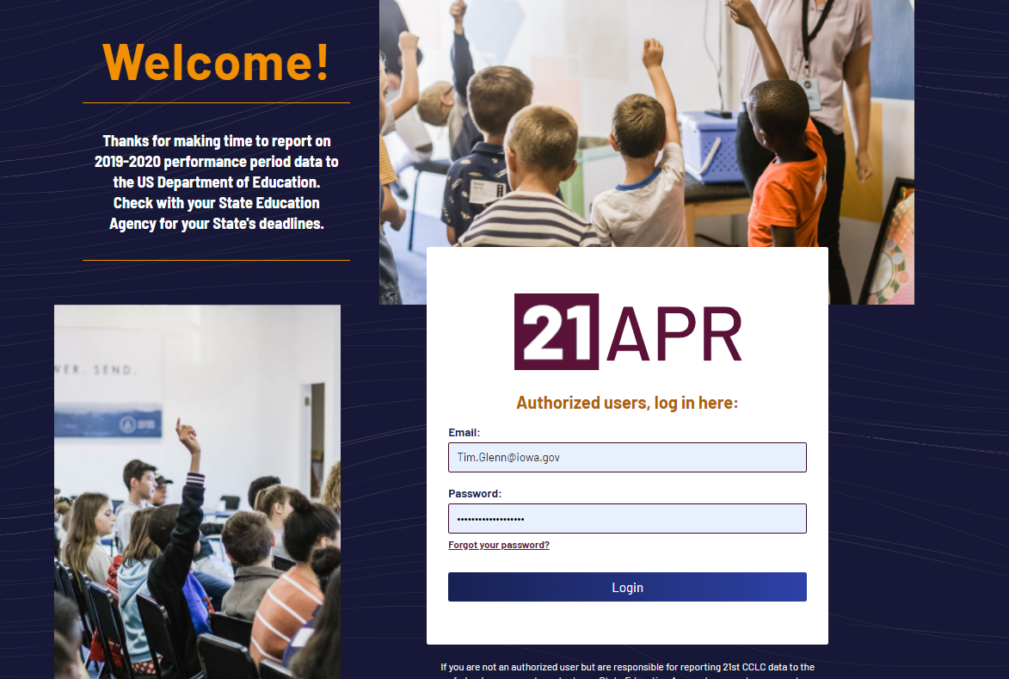
Notes:
This is the login screen,
Notice a link if you have forgotten your password. Tim is also able to reset passwords. Contact Tim by email for a password reset.

Slide 10
Notes:
This is a screen shot of the landing page after you successfully sign into 21APR. You may use either the menu on the left side of the screen or click on one of the tiles located on the right side of the screen.
You can also navigate to the data entry and run reports from this page.
Note the red circle on the last tile indicating how to get to the guides and FAQs in 21APR.

Slide 11
Guides and FAQ
Notes:
21APR has very good support tools with their Quick Guides and FAQs. The Quick Guides are

Slide 12
Three methods of measuring growth
in the APR data system:
ASSESSMENT- Do you have TEST data to document student growth?
GRADES- Did the students receive a grade? Use this to measure growth.
Teacher Reported- Programs do a teacher survey- use this to measure growth
.

Slide 13
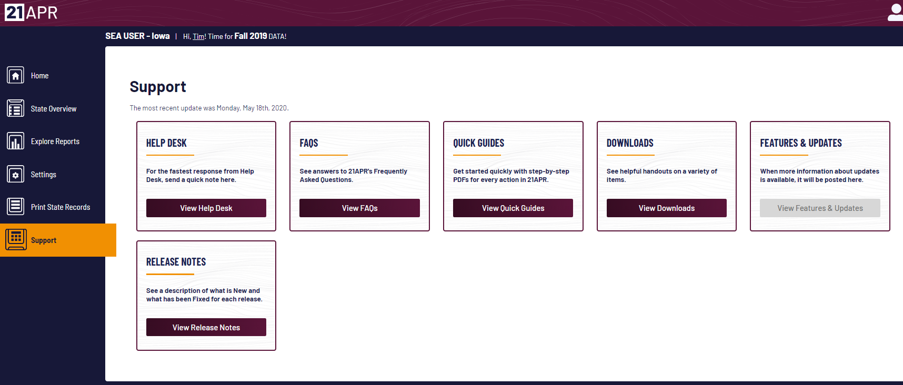
21APR Support Page

Slide 14
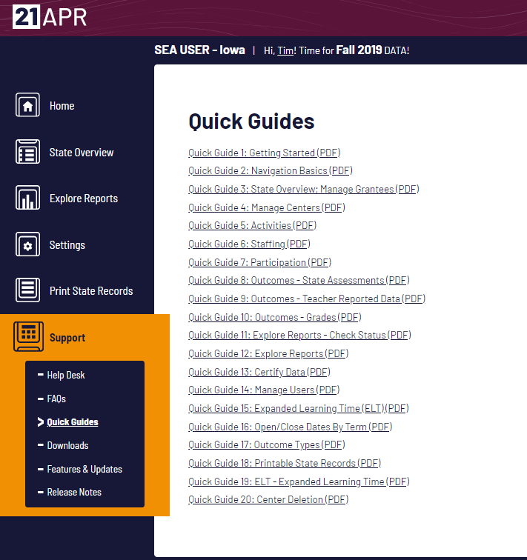
21APR Quick Guides

Slide 15
Example of a Quick Guide
Notes:
First page of Quick Guide #5

Slide 16
Quick Guide Example Continued
Notes:
Second page of Quick Guide #5

Slide 17
Adding or updating Centers --The Center is where the data is entered Adding Activities Adding Staffing Adding Participation Information Adding State Assessment Data (Outcomes)
Notes:
Data is entered for each Center. Each Center has its own Activities, Staffing, Participation and State Assessment Data to enter.

Slide 18
Entering Data into 21APR
Notes:
This is the screen of a State User and Grantees should see a similar screen.

Slide 19
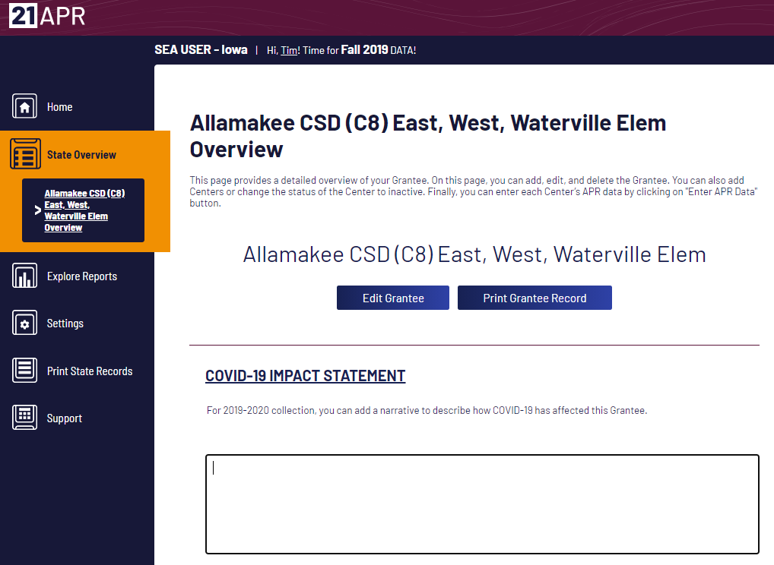
Notes:
See the COVID-19 Impact Statement on this page. Please add information to describe how COVID-19 has affected your program.

Slide 20
This is where a Grantee enters data for a Center. Enter all data for a Center. When a Center has all APR data entered, choose another Center to add data.
Notes:
To enter data into a Center, click the “Enter APR Data” button. Enter all data into one Center at a time. When you finish entering data into a Center you will be returned to this screen to enter data into your other Centers.

Slide 21
Information on Grantee. Update if needed.

Slide 22
Beginning Data Entry
Notes:
When an Academic category is selected a text box will pop up to allow data entry.
The navigation ribbon is circled red.

Slide 23
Second half of Activities Data Entry

Slide 24
21CCLC APR Data Collection Template Fall
21 APR – Activities https://www.iowa21cclc.com/grant-info
Date Range: 6/8/18 - 8/22/18
Category | How many times... | Times a week (if applicable) | Times a month (if applicable) | Avg Hours per session | Average participants | College & Career Readiness?
STEM
Literacy
Tutoring
Homework Help
ELL Support
Entrepreneurship
Arts & Music
Physical Activity
Community / Service Learning
Mentoring
Durg Prevention
Counseling Programs
Violence Prevention
Truancy Prevention
Youth Leadership
College & Career Readiness
Notes:
Pull up website. Add the link to the slide and pop into chat.

Slide 25
Staffing Data Entry

Slide 26
21CCLC APR Data Collection Template Fall
21 APR – Staff https://www.iowa21cclc.com/grant-info
21 APR DATA | SITE 1 |  | SITE 2 |  | SITE 3 |  | SITE 4 |  | SITE 5 |  | SITE 6
STAFF | Paid | Unpaid | Paid | Unpaid | Paid | Unpaid | Paid | Unpaid | Paid | Unpaid | Paid | Unpaid
Administrators
College Students
Community Members
High School Students
Parents
School Day Teachers
Other Non-Teaching School Staff
Subcontracted Staff
Other

Slide 27
Regular attendees (30-59, 60-89, 90+ days)
Have state assessment scores for last year and this year for reading.
State assessment scores
National Standard Score, need to know when test taken
http://itp.education.uiowa.edu/ia/documents/Proficient.pdf
Look for changes in proficiency level
If having trouble getting data from school districts, contact Tim.
Notes:
Comment about assessment scores – MAP testing, grades, teacher survey, FAST scores

Slide 28
Participation Data Entry

Slide 29
How to report different categories of regular students
Notes:
Click on a text box and a counter will appear to assist in data entry.

Slide 30
Bottom portion of Participation Data Entry Screen

Slide 31
21CCLC APR Data Collection Template Fall
Participant Data – Youth Service https://www.iowa21cclc.com/grant-info
Cohort | School | First Name | Middle Initial | Last Name | Student ID | Gender | Ethnicity | LEP | FRPL | Special Needs | Days Attended 8/24/17-6/7/18 | RA
9 | Kirn MS | JOHN | JOSEPH | SMITH | 123456 | 1 | A | 1 |  |  | 13

Slide 32
21CCLC APR Data Collection Template Fall
Participation Data https://www.iowa21cclc.com/grant-info
21 APR DATA - PARTICIPATION | SITE 1 | SITE 2 | SITE 3 | SITE 4 | SITE 5
ATTENDANCE | 0 | 0 | 0 | 0 | 0
<30 days
30-59
60-89
90+
GENDER | 0 | 0 | 0 | 0 | 0
Male
Female
Data Not Provided
RACE / ETHNICITY | 0 | 0 | 0 | 0 | 0
American Indian/Alaskan Native
Asian
Native Hawaiian or Pacific Islander
Black/African American
Hispanic/Latino
White
Two or More Races
Data Not Provided
ATTENDANCE | 0 | 0 | 0 | 0 | 0
K
1st
2nd
3rd
4th
5th
6th
7th
8th
9th
10th
11th
12th
POPULATION SPECIFICS
Limited English Language Proficiency
Free or Reduced Price Lunch Eligible
Special Needs
Family Members?

Slide 33
Top Portion of State Assessment Quick Guide
Notes:
Tim will double check on slides for outcomes and will mention aggregating data from less than 30 days.

Slide 34
Bottom Portion of State Assessment Quick Guide

Slide 35
21CCLC APR Data Collection Template-Fall Outcomes Data https://www.iowa21cclc.com/grant-info
21 APR DATA - OUTCOMES | SITE 1 | SITE 2 | SITE 3 | SITE 4 | SITE 5
State Assessment
30-59 participants reported
30-59 not proficient in reading
30-59 improved to proficient or above in reading
60-89 participants reported
60-89 not proficient in reading
60-89 improved to proficient or above in reading
90+ participants reported
90+ not proficient in reading
90+ improved to proficient or above in reading
Grades
30-59 needed to improve math grades fall-spring
Did improve in Math
30-59 needed to improve English grades fall-spring
Did Iimprove in English
60-89 needed to improve math grades fall-spring
Did improve in Math
60-89 needed to improve English grades fall-spring
Did Iimprove in English
90+ needed to improve math grades fall-spring
Did improve in Math
90+ needed to improve English grades fall-spring
Did Iimprove in English
Teacher Survey
Regular Participants reported
# Distributed *no greater than Regular Participants reported
# Returned
# for Participants 30-59
# for Participants 60-89
# for Participants 90+
30-59 HW Completion & Class Participation
30-59 Student Behavior
60-89 HW Completion & Class Participation
60-89 Student Behavior
90+ HW Completion & Class Participation
90+ Student Behavior

Slide 36
Top Portion of Quick Guide for Printing Reports

Slide 37
Bottom Portion of Quick Guide for Printing Reports
Notes:
Conclusion slide from Tim

Slide 38
Local Evaluation
Much of the same data from your APR input is also used for your Local Evaluation.
The template for your Local Evaluation document can be found under the Evaluation Resources section here: https://www.iowa21cclc.com/grant-info
Completed by you/your site and your local evaluator and is to be turned in annually in November.
By now you should all have an Local Evaluator, but if something happens and you need ideas for those open to contract work can be found at https://www.iowa21cclc.com/grant-info toward the bottom of the page
Notes:
Extension language again.

Slide 39
What does a QUALITY Local Evaluation Document Look Like?
Accurate Data for the Government Performance and Results Act GPRA measures (check your math, check to make sure your data is consistent).
Anecdotal evidence (tell a story about how your program impacts children with quotes and stories).
Pictures (Show children engaged in activities, no poses- we cannot use these per new state guidelines).
Local Goals- Reasonable and Measurable. Five goals are ideal. Do not simply repeat the GPRA measures, but report on things you are doing locally. Example: > 50% of all regular attendees will learn to swim at the community pool. >50% of parents will attend parent engagement meetings.
Anecdotal evidence
Pictures

Slide 40
Example:
Narrative about your program attendance:
Enrolled youth and their families are asked to commit to high levels of attendance for the best possible outcome.
Program numbers indicate that children who enroll in the program enjoy it and remain engaged. Of the 99 total youth enrolled during the 2018-2019 school year, all 99 (100%) attended at least 30 days of programming and in fact all 99 attended 90 days or more.
Staff believed the primary reasons youth came to programming were:
they enjoyed the activities, 2) they needed a safe place to be after school,
3) youth and their families had positive relationships with staff, and
4) nightly dinner services eliminated a huge barrier for families.

Slide 41
Statewide Annual Survey
Done via a Survey Monkey link that is sent out by Crystal/Iowa Afterschool Alliance in November and will be due in January of 2021.
We also provide a PDF that can be printed and we recommend you pencil your answers out before you enter your data into the survey.
Similar data that is collected via the APR and Local Evaluation Tool but also asks:
Basic site and cohort(s) info
Information about fees charged (if applicable)
Transportation, meals, and other program supports (ex. referrals)
Staff Professional Development
Program logistics – how and when do you operate your program (ex. hours and days, but also how often is tutoring offered and in what format)
Youth growth through programming – community involvement, leadership
Communication Plan – how and when do you talk to parents
Links to your social media and website URLs

Slide 42
Other reminders for data collection
Teacher surveys – these two question surveys can be found at https://www.iowa21cclc.com/grant-info. Information from these are due in the APR system when you complete your school year data. You’ll want to secure a response for ALL youth in your program. We recommend you give teachers plenty of time and a reminder that this can be done via pen/paper or you can make this an online survey. Federal statute that requires APR data to be submitted accurately and on time. EDGAR §76.770 UGG §200.331(d)(1) UGG §200.328(a) UGG §200.328(b)
Professional Development – this template (also found at the link above) may be requested by the Department at any time but definitely at your site visit(s). We recommend you update regularly – after each training, quarterly, etc.
Federal statute on PD-§4202(c)(3)(B) §4202(c)(3)(D) §4203(a)(6) UGG §200.331(e)
Notes:
Add code for all of these data collection.

Slide 43
Other reminders for data collection
Community Partnership – again, the template can be found using the link on this page. Your partnerships are required to be collected by the Department annually. This form is available to you at any time but will be collected annually by the IAA in June. Required by ESSA- ESSA 4203 (11) describes how the State will-
(A) pre-screen external organizations that could
provide assistance in carrying out the activities under this part; and
(B) develop and make available to eligible entities a list of external organizations that successfully completed the pre-screening process;

Slide 44
Vic Jaras – vic.jaras@iowa.gov Tim Glenn – tim.glenn@iowa.gov Crystal Hall – chall@sppg.com
Questions?
Notes:
You can use this slide as your opening or closing slide. Should you choose to use it as a closing, make sure you review the main points of your presentation. One creative way to do that is by adding animations to the various graphics on a slide. This slide has 4 different graphics, and, when you view the slideshow, you will see that you can click to reveal the next graphic. Similarly, as you review the main topics in your presentation, you may want each point to show up when you are addressing that topic.
Add animation to images and graphics:
Select your image or graphic.
Click on the Animations tab.
Choose from the options. The animation for this slide is “Split”. The drop-down menu in the Animation section gives even more animations you can use.
If you have multiple graphics or images, you will see a number appear next to it that notes the order of the animations.
Note: You will want to choose the animations carefully. You do not want to make your audience dizzy from your presentation.

