Slide 1
New Grantee/Staff Transition Committee: Gearing Up for Summer
June 24, 2021 with Crystal Hall (Iowa Afterschool Alliance) and Vic Jaras (Iowa Department of Education)

Slide 2
Attendance and Roll Call
Please introduce yourself and the site you work for.
What is one summer activity you are looking forward to?

Slide 3
Getting back to normal – “living in a post-COVID world”
What does your “new normal” look like at your site?

Slide 4
Data Collection
Never fear! We put together a template for you that can be found here: https://www.iowa21cclc.com/grant-info
“New” template coming soon for the new GPRA and tracking needs
Normally during the summer months sites can expect to collect the following data:
Attendance
School/site/center
Grade – use the grade they just completed
Demographic data: gender, age, race, ethnicity
Students FRPL status
Is this student an LEP or Special Needs learner

Slide 5
Data Collection
Sites should also expect to track:
Program offerings in the following categories: STEM, Literacy, Tutoring, Homework help, ELL Supports, Entrepreneurship, Art & Music, Physical Activity, Community or Service Learning, Mentoring, Drug Prevention, Counseling, Violence Prevention, Truancy Prevention, and Youth Leadership
How many times those programs were offered using these choices: weekly, monthly, term and then additional dependent upon that choice (ex. monthly: twice per month or weekly: 3 times per week)
How long those programs lasted using these choices: less than an hour, 1-2 hours, 3-4 hours, more than 4 hours
How many youth participated. This is also broken down by groups: less than 5, 5-10, 11-20, etc.
Is the program part of a College and Career Readiness plan
Staffing patterns: how many administrators, paid staff, college students, community members/volunteers, etc.

Slide 6
Data Collection
Outcomes
State Assessment Data – proficiency data
Teacher Survey Data – behavioral data
Grades from Fall to Spring – needed improvement/improved
YOUR LOCAL OBJECTIVES NEED TO BE TRACKED TOO!

Slide 7
Activities
During the summer, sites are still expected to incorporate academics into the daily program routine. However, the approach may be a bit more relaxed. Examples of this include:
Many more outdoor educational activities like gardening or nature exploration
Field trips that can include academic prep and components: zoo, park, museums, etc.
Physical games that may include an educational component: spelling word basketball, site word kickball, etc.
Lots of STEM!
Social Emotional Learning

Slide 8
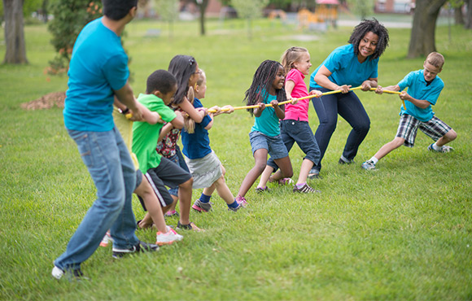
What are you doing at your sites this summer?

Slide 9
Program Hours
During normal operation, sites are required to meet for 30 days in the summer months. We encourage sites to schedule more than 30 days (ex. 35) to ensure that this expectation is met. While cancellations due to weather are less common in the summer, they do happen and it’s better to be safe than sorry.

Slide 10
Virtual Resources
Kahoot
Flippity
Google Access
Zoom
Google Classrooms
Mind Works
Facebook Live
Don’t forget to check out the IAA’s Newsletter which also often includes additional resources and links to activities

Slide 11
Questions or Comments?

Slide 12
Thank you and Good Luck!
It is always a good idea to share your summer plans with Vic.
Crystal, Britney and Emilee are also here to help you with any of your summer or year round needs.

