Slide 1
Supporting Program Staff and Planning for Afterschool Professionals Appreciation Week
Best Practice Webinar - February 23, 2021
Iowa Afterschool Alliance

Slide 2
Let’s start with a Jamboard!
Please use the link in the box to access the Jamboard for this next section.
To access the Jamboard, please use the link here: https://jamboard.google.com/d/1gABEY7mGXW_s5qEbva7HJxuDuzFN4AjX1LC2k2K5TnA/edit?usp=sharing
These will be anonymous so feel free to answer honestly.
Notes:
Populate Jamboard with these questions
Link: https://jamboard.google.com/d/1gABEY7mGXW_s5qEbva7HJxuDuzFN4AjX1LC2k2K5TnA/edit?usp=sharing
Make sure to give a demonstration on how to use Jamboard
To build into Jamboard:
When I think of my current staff, I feel: Ex: Pumped! I have a great staff, I have some good ones and ones that need some work, My staff is not my dream-team right now, I need to hire.
One of my staff’s greatest strengths is:
One challenge that my staff gives me is:
Is your sites currently full-staffed, partially staffed, under staffed? – Put this in the chat?
What are a few characteristics of your “ideal” staff person?

Slide 3
What does your program staff mean to you?
Notes:
This word cloud is from a previous training in which managers were asked to list all the words that came to mind when they were working with their current staff. You can see that there are plenty of positives – need, good, friends, family; some that are negative – struggle, late; and some that could go both ways – without? Retire? The one that strikes me most is “human,” because it’s really this that drives home this point. We are humans in a job that requires us to be very, very human. We will be asked to deal with lots of emotions, headaches, heartaches, successes, challenges, triumphs, heartbreaks, you name it! And because many of you spend multiple hours per day with your staff, your interactions with them can feel like a family full of love as well as a hitting a rut.

Slide 4
Why High Quality Staff is Important to Your Program
Youth!
Relationship Development/role modeling - https://www.search-institute.org/developmental-relationships/learning-developmental-relationships/
IAA quality standards - https://www.iowaafterschoolalliance.org/quality
So to better support youth, we MUST recruit AND retain high quality staff.
Notes:
Cue up this website: https://www.search-institute.org/developmental-relationships/learning-developmental-relationships/ and https://www.iowaafterschoolalliance.org/quality
Let’s take a moment to see what the Search Institute has to say about why forming relationships between staff and youth is important.
Also, the IAA identifies that staff-student relationships are an important piece of any quality program and can be found in the quality standards document.

Slide 5
Why High Quality Staff are Important to Your Program
The right member of your team can:
Meet your organization’s VALUES
Demonstrate CHARACTER, LEADERSHIP, GROWTH MINDSET and PROBLEM SOLVING for your youth
Builds your teams CONCEPTUAL and STRATEGIC THINKING
Creates a sense of SOCIABILITY and RELIANCE among team members
Supports your program’s efforts to be ADAPTABLE while making LEARNING CONNECTIONS
Notes:
The following information was taken from a slide presented to the New Grantee-Staff Transition Committee in the spring of 2020. Dau Jok was the presenter.
I’d like to encourage you to use the worksheet template that I just dropped into the chat to jot down your responses to these characteristics so you can readily think about your staffing needs and how they meet your school or site’s goals.

Slide 6
Just for fun…
https://www.youtube.com/watch?v=wuo13FrNX6g

Slide 7
Staffing and Volunteer Considerations
The Iowa Afterschool Alliance recently put together an Afterschool in a Box Toolkit that can be used as a guide for sites who are wanting to start a program or for existing sites to “brush up” on a component of their program.
We are going to spend the next few minutes reviewing some of the information in this kit. You can find these materials here: https://www.iowaafterschoolalliance.org/afterschool-in-a-box
Let’s talk about recruitment, retention, how to write a quality job posting, and how volunteers fit into your model.
Notes:
Cue up this website and have the PDF of the section ready to go. PDF is saved to your desktop.
https://www.iowaafterschoolalliance.org/afterschool-in-a-box
Be sure to demonstrate how to navigate the document.

Slide 8
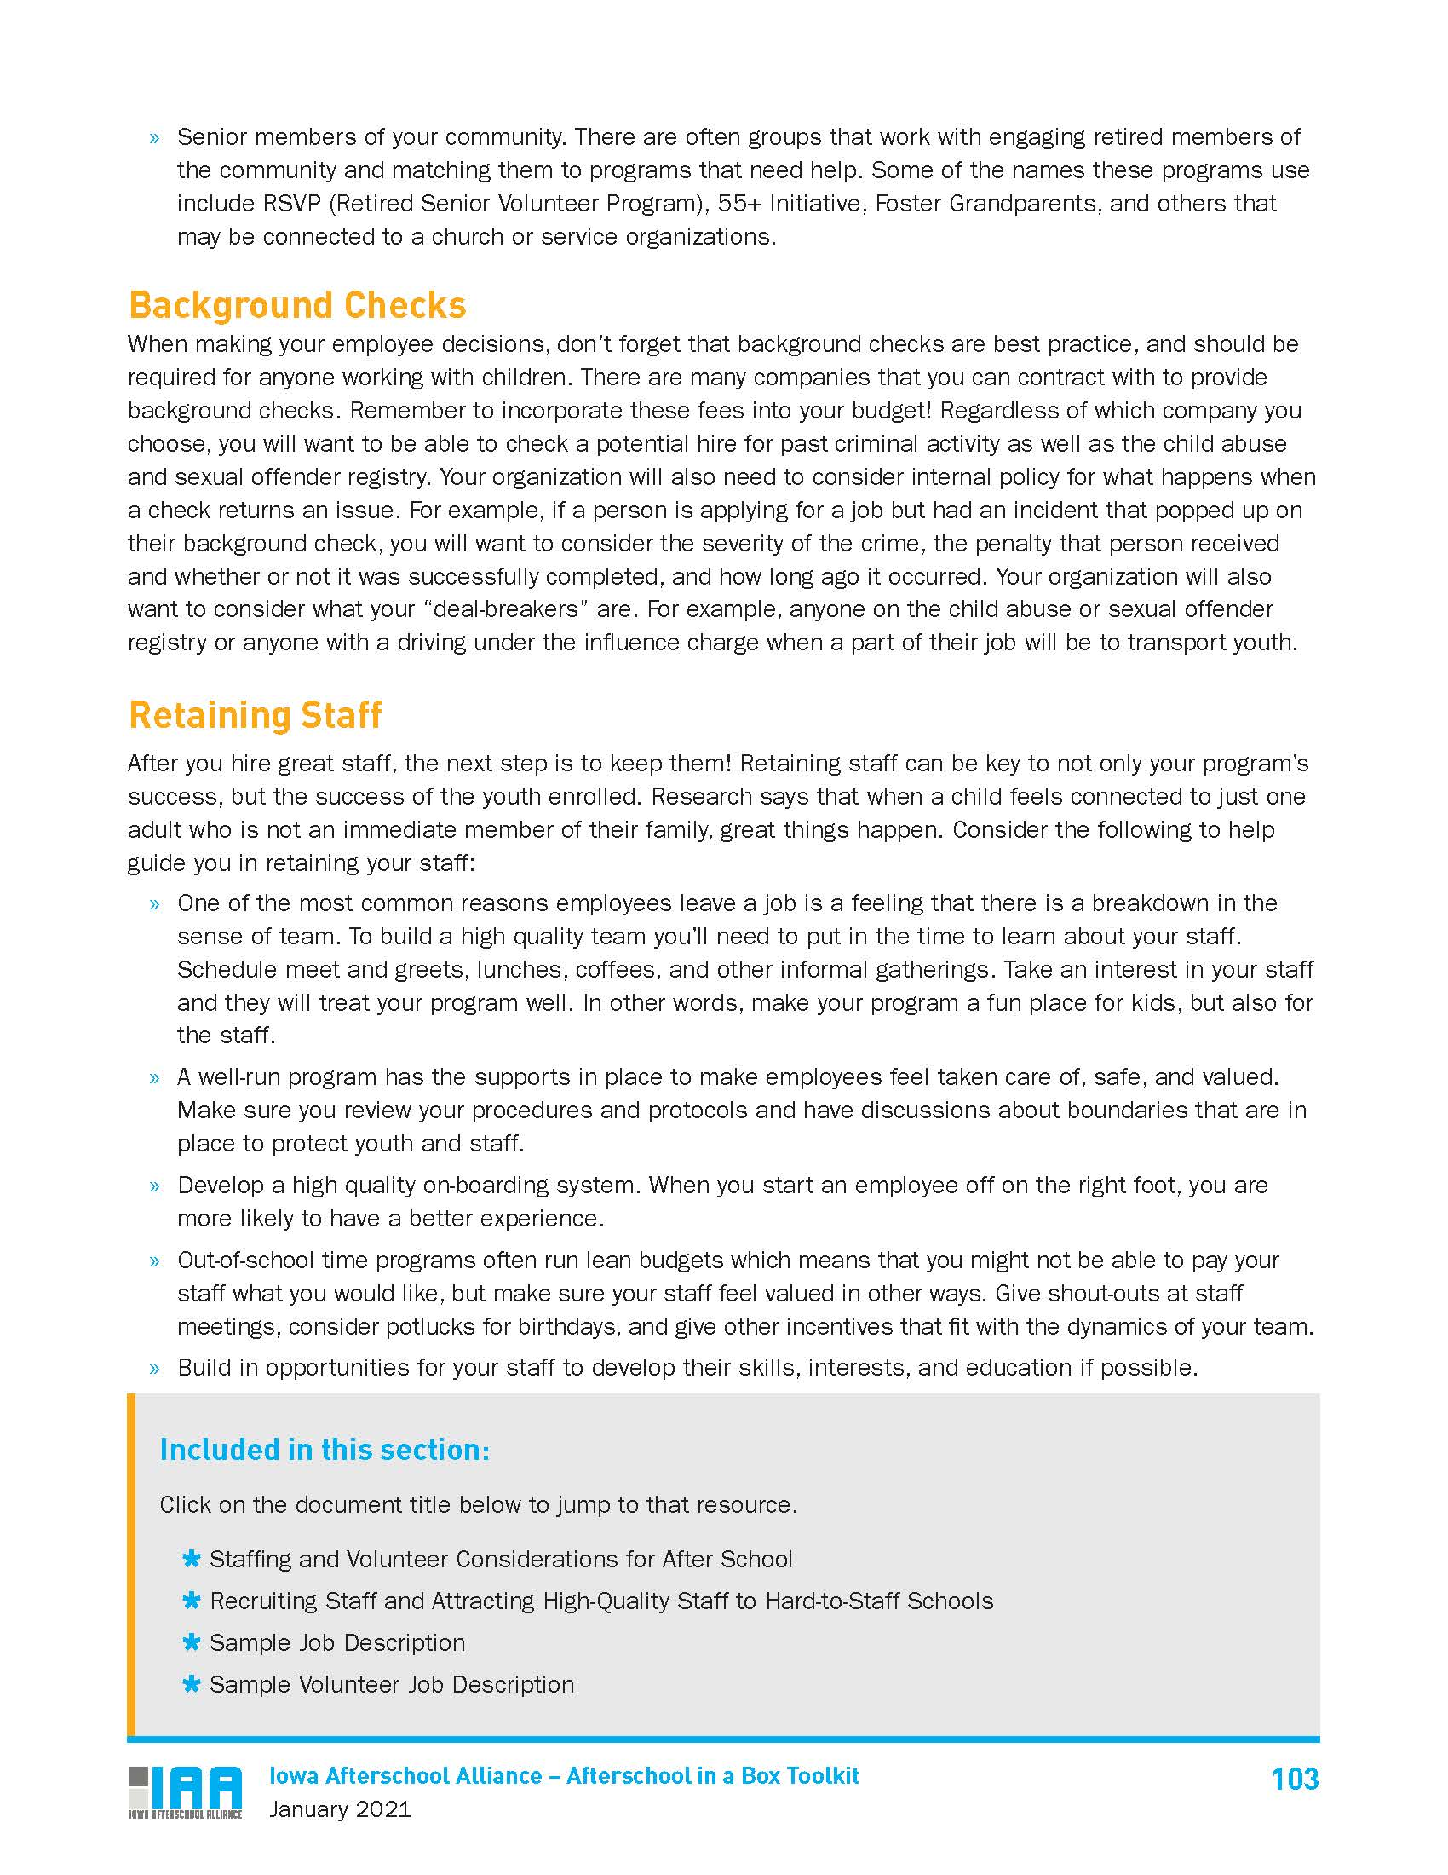
Accessing the Toolkit
Notes:
Generally point out what is included in this section demonstrating how they can find the supporting materials. Focus on Retention on page two. Read from the bulleted suggestions and take comments from the group.

Slide 9
How do you currently support your staff?
Feel free to unmute or use the chat to share with us the ways you make your staff feel supported and a part of the team.
Notes from the field
Recognitions – employee of the month, bio wall, social media
Celebrating birthdays, milestones, “fun and weird days”
Staff coffees, lunches or outings (before COVID)
Fun virtual events – online games, trivia, happy hours

Slide 10
Why do you need to support your staff?
How will supporting your staff lead to better outcomes for youth in your program?
How will supporting your staff lead to better parent-site communication?
How will supporting your staff lead to a better sense of team?
How will you continue to support your staff and what’s one new thing you’d like to try?
Notes:
Allow for silent reflection, chat box, unmute, etc.

Slide 11
Afterschool Professionals Appreciation Week April 19-23, 2021
All content on the next two slides is credited to the National Afterschool Association which can be found here: https://naaweb.org/naa-events/afterschool-professionals-appreciation-week
Ideas and Toolkit
Please note that many of the materials on this website are still for the 2020 event but can be modified for your content.
The IAA will be doing some social media this week as well. We would love for you to share your ideas with us!
A+ Afterschool
Notes:
Cue up this website: https://naaweb.org/naa-events/afterschool-professionals-appreciation-week
Be sure to ask Emilee if there are other social media thoughts or events to promote here.

Slide 12
Questions?
The IAA is here for you to bounce ideas off of, point you in the direction of recruitment resources you perhaps didn’t think about, and provide any other connections needed to continue to grow your program.
Crystal Hall, chall@sppg.com
Britney Samuelson, bsamuelson@sppg.com
Emilee Harris, eharris@sppg.com

