Slide 1
Recruiting Staff, Activity Leaders, and Volunteers to Support your Program
by: dau jok, ost enrichment coach & crystal hall, iaa

Slide 2
Introduction
Who’s on the call today? Please share your name, role, and site
How many employees does your program currently have?
Are you fully staffed right now?

Slide 3
Dream big
What characteristics does your ideal staff person, volunteer, or activity leader have?

Slide 4
Why quality staff is important to your program
Youth!
Relationship Development/role modeling - https://www.search-institute.org/developmental-relationships/learning-developmental-relationships/
Iaa quality standards - https://www.iowaafterschoolalliance.org/quality

Slide 5
Tools from Search institute
https://www.search-institute.org/relationships-check
Use as a tool for checking in with youth during this pandemic
Consider incorporating this mindset into your hiring process

Slide 6
Iaa quality standards

Slide 7

Creating an environment people want to be a part of…

Slide 8
Attracting talent
Talent: an individual’s knowledge, skills, and abilities, what the person has done and what the person is capable of doing or contributing to the organization in the future (Silzer & Church, 2009).
Set conditions in your organization
  Safe workplace
  On-boarding
  Career progression/why your organization
  Employee engagement

Slide 9
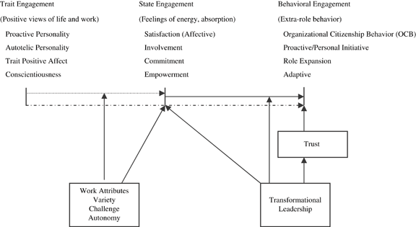
Framework for Understanding the Elements of Employee Engagement

Slide 10
Potential Teammate
Your organization’s VALUES
CHARACTER
Leadership
Problem Solving
Cognitive skills (conceptual & strategic thinking)
Personality Traits
  Interpersonal skills
  Sociability (interview)
  Resilience (work history)
Learning
  Adaptability (scenario)
  Growth mindset (Dr. Carol Dweck)
  Learning orientation

Slide 11
Why volunteers and volunteer activity leaders?
How does your program currently use volunteers?
Where/how do you recruit?
How has this changed?

Slide 12
What volunteers can do for your site
Experts in their field
Build relationships
Role modeling
Staffing support for programming
Staffing support for development
Free labor…

Slide 13
Btw…Benefits of volunteering
Increases feelings of happiness and decreases depression, anxiety, and other feelings of loss
Builds confidence
Provides purpose
Physical health improvement – reduced blood pressure, improves memory.
Volunteers live longer!

Slide 14
How to engage volunteers during a pandemic
Virtually – reading, online tutoring and homework help, math instruction, Game play
In person with social distancing – material distribution, outdoor activities
Guest speakers
Service learning with social distancing
Administrative work – captioning, fundraising, grant writing, proofreading, etc.
Other ways? What are you doing?

Slide 15
Questions?
Crystal Hall – chall@sppg.com
Dau jok – daujok@gmail.com

Slide 16
References
  Search institute – www.search-institute.org
  Iowa afterschool alliance – www.iowaafterschoolalliance.org
  Macey, W. H. & Schneider, B. (2008). The meaning of employee engagement. Industrial and Organizational Psychology, 1, 3-30.
  Silzer, R. E. & Church, A. H. (2009). The pearls and perils of identifying potential. Industrial and Organizational Psychology, 2, 377-412.

