Slide 1
New Grantee Meeting: The Nita M. Lowey 21st Century Community Learning Centers 2022
DE CONSULTANT -Vic Jaras
IAA STAFF-Heidi Brown

Slide 2
Introductions- how will your program help kids?
PLEASE PROVIDE YOUR EMAIL and CELL PHONE NUMBER

Slide 3
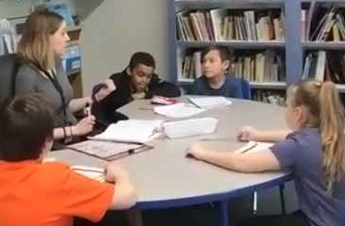
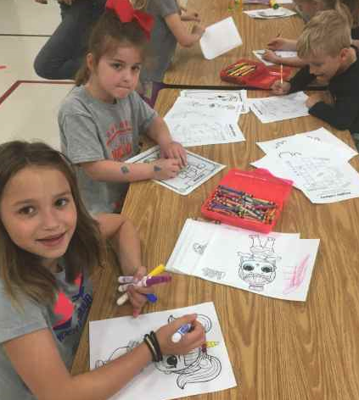
AGENDA
OVERVIEW OF THE PROGRAM-Contract Obligations
About Iowa 21st CCLC
FIRST STEPS
21CCLC Grantee Timeline and Yearly Activities
FAMILY Engagement Guide
SUPPORT, MONITORING AND ATTENDANCE
Guidance on Attendance
The importance of field trips
BUDGETS AND FINANCE
GUIDE to Program Budgets and DE guidance on Finance
PROFESSIONAL DEVELOPMENT
DATA AND EVALUATION- Evaluation support docs online
CHILD CARE CONTRASTED WITH 21st CENTURY

Slide 4
OVERVIEW OF THE PROGRAM-Contract Obligations
About Iowa 21st CCLC

Slide 6
OVERVIEW: “The 21st CCLC program provides an opportunity for us to make a difference in the lives of children.”
For those who have not been successful in school, we help kids reconnect to learning in different ways.
We provide academic aid, enrichment activities, social emotional learning, nutritional food, and fun to children who need it most.
You are expected to build a model program of afterschool that will be shared via your data, committee calls, site visits, presentations, web sites and within your community.

Slide 7
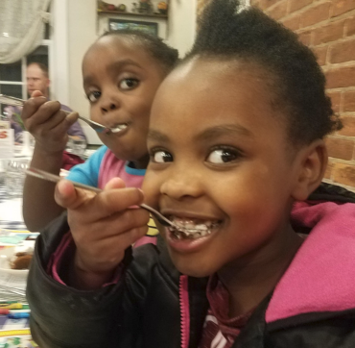
The 21st Century Community Learning Centers grant is a federal title program (Title IVB)
ALL Federal Title programs focus on children in poverty and children with achievement gaps.
This program requires a grant competition to distribute funding around the state.
The program requires data reporting in an online system (Annual Performance Report or APR) for Summer, Fall and Spring each year.
If you follow the guidance, this program will help you reach your at-risk kids, increase attendance, reduce referrals and improve student achievement.

Slide 8
The purpose of this important program is to create community learning centers that provide academic enrichment opportunities for children, particularly students who attend high-poverty and low-performing schools, to meet State and local student standards in core academic subjects, to offer students a broad array of enrichment activities that can complement their regular academic programs, and to offer literacy and other educational services to the families of participating children. (USDOE guidance)

Slide 9
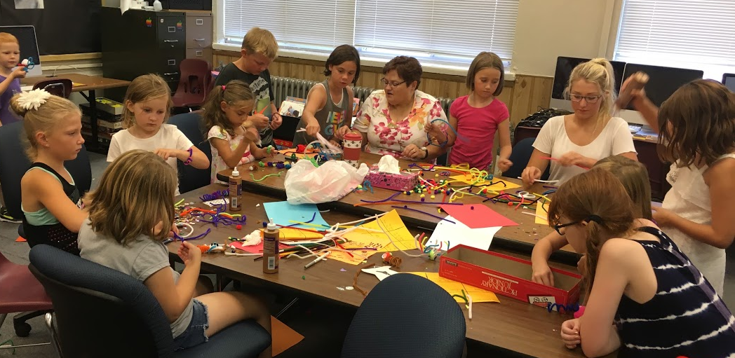
Popular enrichment activities include: Crafts, Cooking, Chess, STEM, Outdoor Activities, and Community Guests.

Slide 11
FACT:
This year, I visited one urban site that reduced referrals from 2,007 a year to 224 because of their afterschool program.
We have provided training in Conscious Discipline around the state to help programs.

Slide 12
Contract Obligations:
This is on EVERY grant agreement for this program.

Slide 13
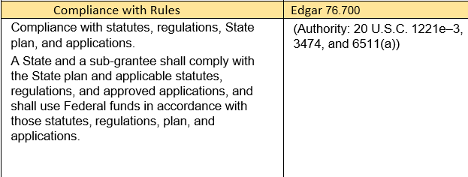
We have code citations for all our required activities

Slide 14
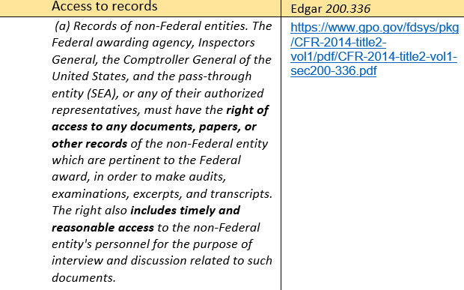

Slide 15
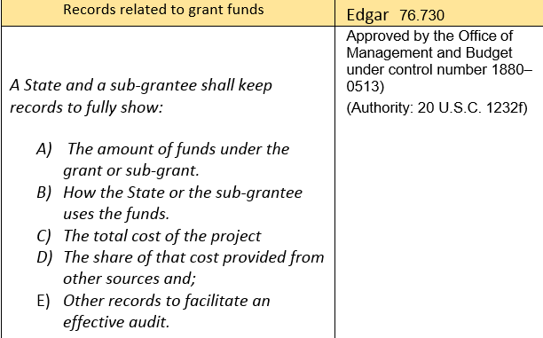

Slide 16
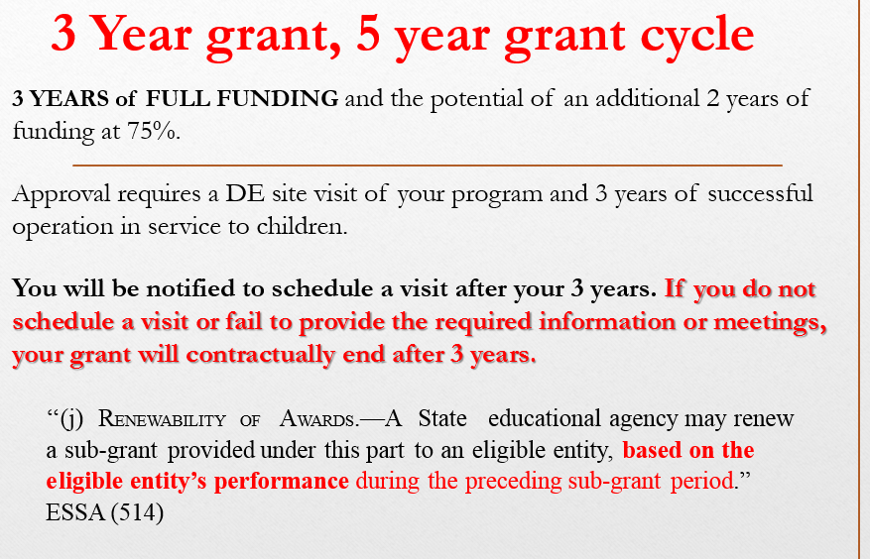

Slide 17
PLAN THE PROGRAM, HIRE STAFF, BUY SUPPLIES
ENROLL STUDENTS
TAKE ATTENDANCE EVERY DAY
COMMUNICATE ACTIVITIES TO PARENTS
WORK WITH SCHOOL PRINCIPAL AND STAFF TO SUPPORT THE NEEDS OF CHILDREN
HOLD A FAMILY ENGAGEMENT MEETING (MINIMUM OF ONE PER QUARTER)
ENROLL IN A BEST PRACTICE COMMITTEE
ATTEND PROFESSIONAL DEVELOPMENT EVENTS, WEBINARS AND TRAININGS
SUBMIT CLAIMS ON TIME AND WITH DOCUMENTATION
TIP: YOU WILL RECEIVE EMAILS ABOUT THE APR DATA REPORTING BUT YOU WILL NOT DO THIS YOUR FIRST YEAR BECAUSE WE REPORT EVALUATION DATA ONE YEAR BEHIND.

Slide 18
FIRST STEPS:
21CCLC Grantee Timeline and Yearly Activities
FAMILY Engagement Guide

Slide 19
FIRST STEPS:
1. Enroll children in your program
2. Recruit teachers and community groups to provide engaging enrichment
3. Buy supplies and snacks
4. Have a Parent Engagement Meeting (every quarter)
5. Have a budget planning meeting
6. Monitor how your program is operating- if you need help- contact Vic
7. The Iowa Afterschool Alliance will do a Best Practice site visit your first year and help you with PD, partnerships and resources to help you succeed.

Slide 20
START YOUR PROGRAM
Focus on the needs of children - More programs providing full meals
Developing partnerships (Community Colleges, 4H, United Way, Nutrition, Physical Education, and More) - over 700 partners - up from 24 in 2011
Gathering Your data–Data helps validate our good work
Improving our evaluation (ERMS) - Collects data for state evaluation-training for local evaluators. Local evaluations are posted on your web site.
Committees to share and improve our work-A community of practice
Reading is our Priority along with Math-We report this data to Congress via the APR online data system.

Slide 21
Family engagement: 4 meetings a year (min)
Inform families about the program –showcase some activities each meeting
Recognize the achievements of children (attendance, behavior and academics)
Partner with a Community College to support Adult Literacy (a required partnership)
Partner with a local restaurant to provide food at this meeting
Do a cultural potluck to share different foods and learn about each other
Ask parents to volunteer on field trips or a Saturday event
- SEE THE GUIDE TO FAMILY ENGAGEMENT

Slide 22
SUPPORT, MONITORING AND ATTENDANCE
Guidance on Attendance
The importance of field trips

Slide 24
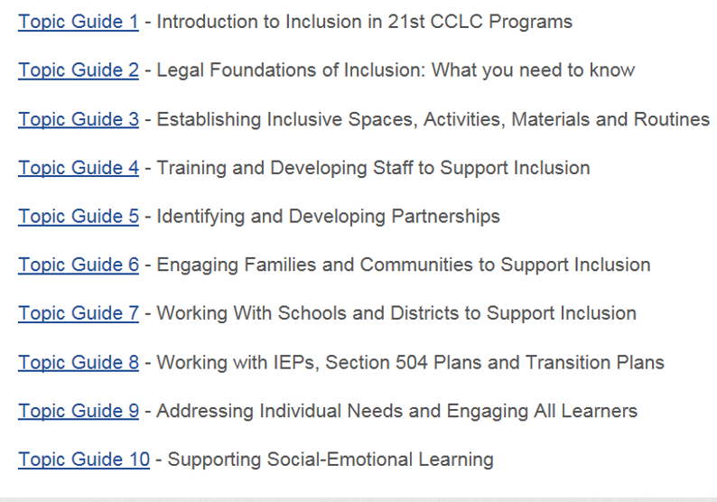

Slide 25
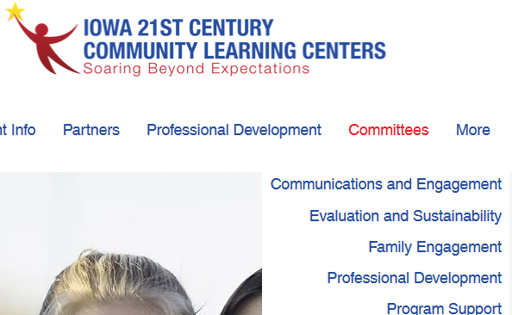
COMMITTEES: A Community of practice
We have five* committees- you are required to participate in one of the five committees for each cohort your are funded in.
COMMUNICATIONS and ENGAGEMENT
EVALUATION and SUSTAINABILITY
FAMILY ENGAGEMENT
PROFESSIONAL DEVELOPMENT
PROGRAM SUPPORT
*NEW GRANTEE-STAFF TRANSITION
Support website -www.iowa21cclc.com

Slide 26
New Grantee / staff turnover
This committee meets monthly and is designed to provide additional support in the operation of the program.
IF YOU HAVE STAFF TURNOVER- YOU MUST ENROLL THE NEW STAFF IN THIS COMMITTEE
IF YOU HAVE STAFF TURNOVER- YOU MUST NOTIFY THE IOWA DEPT. OF EDUCATION VIA EMSAIL WITH THE NEW STAFF NAMES, POSITION, CONTACT INFORMATION.
According to statute a significant staff turnover elevates your RISK STATUS. Contact Vic ASAP when you have any staff turnover (director, finance, coordinators but not normal support and teaching staff). The IDOE will determine the need for additional risk monitoring based upon the information you provide.
We have a guidance sheet for this requirement.

Slide 27
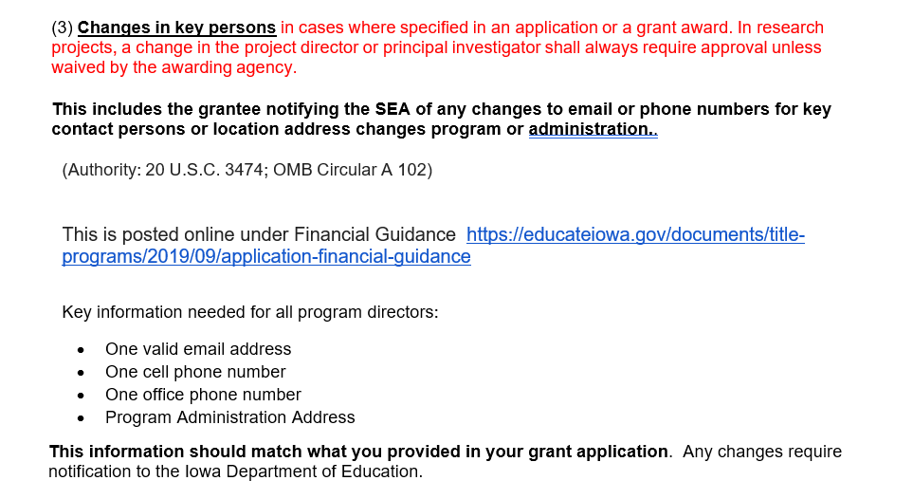

Slide 28
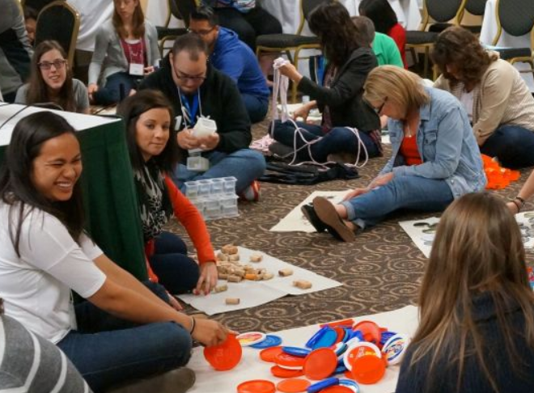
PROFESSIONAL DEVELOPMENT:
EVERY YEAR WE PROVIDE:
STATE CONFERENCE - Attendance is required for all
NEW Award MEETING (required if you were awarded)
REGIONAL WORKSHOPS: (select one)
Committees (Join one committee per cohort funded)
Technical Assistance Meetings for the grant application.
Other Meetings / Trainings as needed

Slide 30
Iowa was approved by the US DOE to do Risk Assessment and Monitoring as part of our regular operations.
Other states require an annual risk assessment and monitoring report to be submitted by grantees.

Slide 31
How to reduce the “anxiety” of State Monitoring:
Understand that our priority is the help the grantee be successful in serving children
Many of the Site Visit requirements were embedded in the application
ALL the site visit documents are posted on the IDOE website – You have months to review them and ask questions via email or phone
You will receive reminder emails- it is a good idea to read them
Follow the guidance- and your program will succeed
What? Of course I don’t have the Sustainability Plan ready yet. I know I had 3 years to work on it.

Slide 32
SEA Requirements: What the state must do:
II.2 Does the SEA conduct regular, systematic reviews of subgrantees to monitor for compliance with federal statutes and regulations, applicable state rules and policies?
4202(C)(3)(A)
EDGAR §76.770
UGG §200.328(a)
UGG §200.331(b)(d)
Federal Statutes that requires us to monitor your program

Slide 33
TWO EXAMPLES FROM IOWA

Slide 34
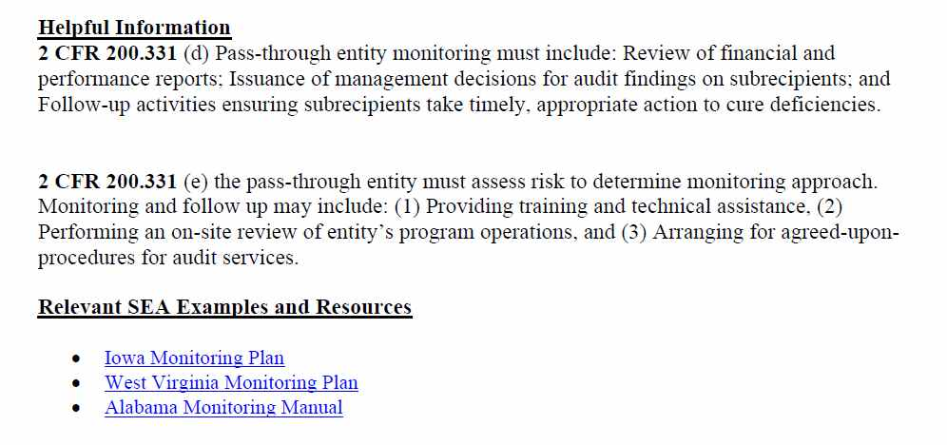

Slide 35
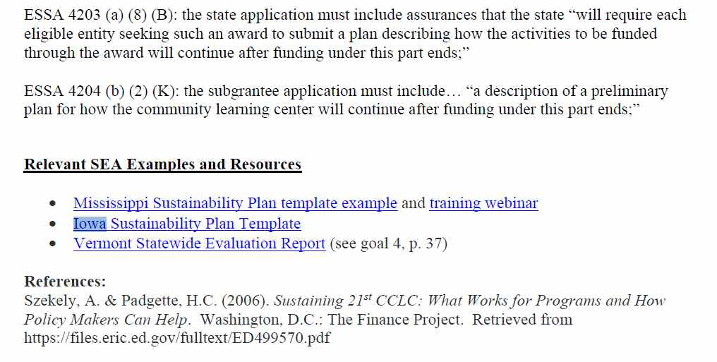

Slide 36
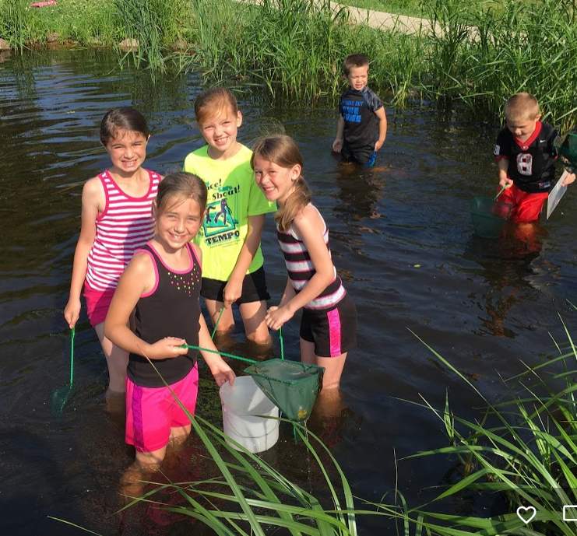
Kids love to go outside and learn about nature
Partner with the Iowa Dept. of Natural Resources
https://www.iowadnr.gov/Conservation/For-Teachers/Classroom-Resources

Slide 37
Community College Partners
Community Colleges receive federal dollars to provide Adult Literacy education. They are happy to partner with you.
Adult Literacy –GED Preparation
College Volunteers to work in your program
Pre Service Teachers to work in your program
Field Trips to the College to learn about programs they offer
NEW FUNDING STARTING JULY 1, 2019

Slide 38
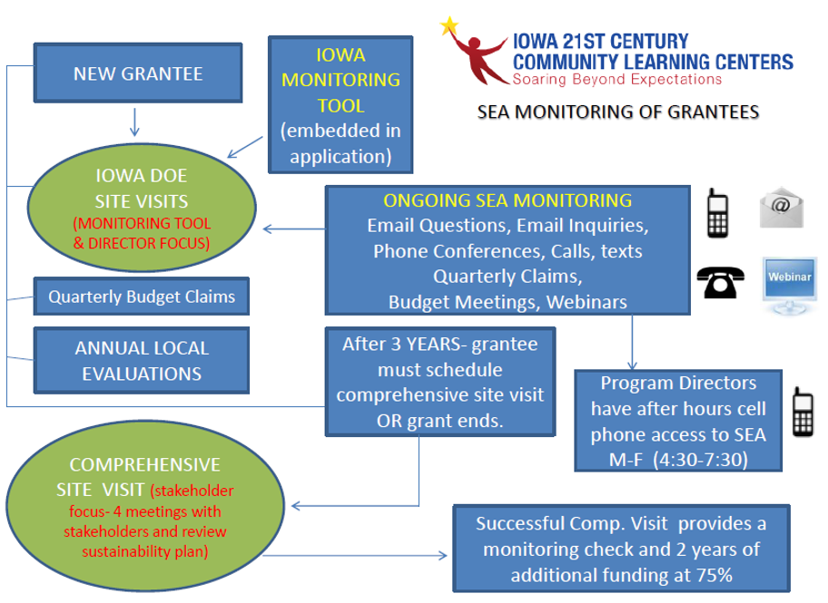

Slide 39
ATTENDANCE
Iowa ranks first in the nation in the percent of children under 6 years of age with all parents in the labor force (75.6 percent) - U.S. Census Bureau
“Improving attendance is an essential strategy for reducing achievement gaps. State and national data shows that students from low-income families are more likely to be chronically absent than their peers (Ginsburg, Jordan, Chang, 2014).”
If you do not meet your grant attendance goals, your funding will be reduced.

Slide 40
Support, Monitoring and attendance
In Iowa, we do things a bit different from other states. We have:
More Community Partners than any other state (over 700)
Excellent Reading average- 66% 70% IA state average for all children
Good Attendance – 56%
About half our sites feed children a full meal- some states do not allow food
Excellent Support- Online Resources, Face to Face Meetings, Committees, Site Visits and Technical Assistance Meetings.

Slide 41
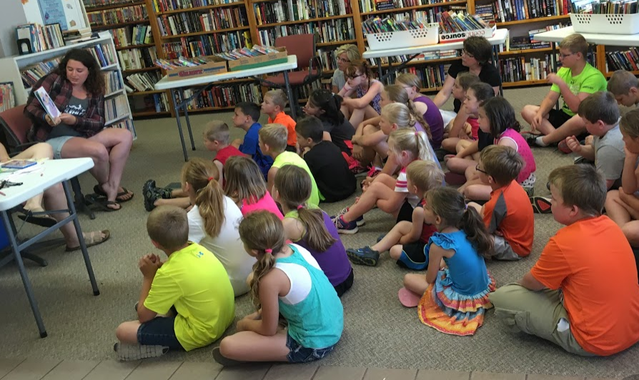
Reading aloud to the children-meeting Iowa Core Standards
VIC TIP- Weather permitting, you could do a read aloud outside to facilitate improved social distancing.

Slide 42
Support & Monitoring: Site visits
We have different site visits to support and monitor programs.
The DE Site Visit. There is an 11 page monitoring checklist used and posted online. This will be sent to you via email before a site visit.
https://educateiowa.gov/documents/title-programs/2022/09/appendix-d-iowa-site-monitoring-documentation-form
Second, the DE Comprehensive Site Visit- after 3 years, to determine if you qualify for an additional 2 years of funding.
https://educateiowa.gov/documents/title-programs/2022/09/appendix-e-iowa-comprehensive-site-visit-21st-cclc
Note: Most DE site visits may be virtual via ZOOM.

Slide 43
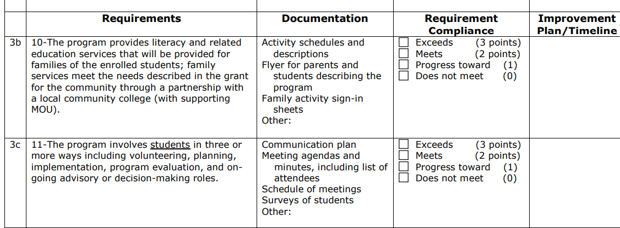
Example of the 11 page checklist:
https://educateiowa.gov/documents/title-programs/2022/09/appendix-d-iowa-site-monitoring-documentation-form

Slide 44
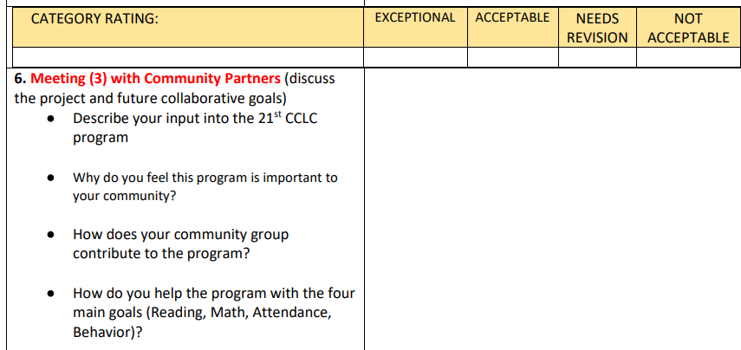
After 3 years, you will receive a Comprehensive Site Visit:
This visit will be a series of meetings with all stakeholders
Staff, Principal,
Parents, community partners, finance, and administration.

Slide 45
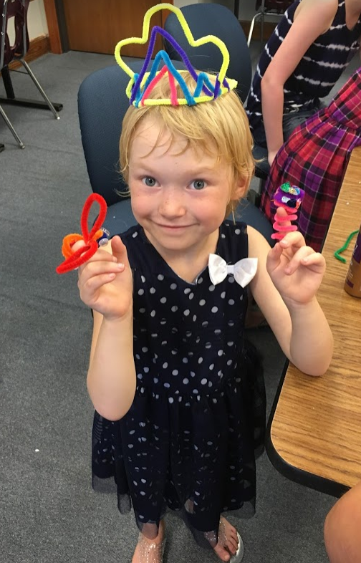
The snack today was much better than we usually get.
Talking with the children on a site visit provides un-scripted information about the program.
I ask them: “Do you like the program?”
What was your favorite activity?
Are you making new friends?

Slide 46
ATTENDANCE REQUIREMENTS:
You will report your attendance each quarter on your claim form- The number enrolled, and the average daily attendance for the quarter.
On your application your attendance goals should be monitored.
After year one, you should have met 70% of your attendance goal.
After year three, you should have met 80% of your attendance goal.
Attendance is reported in the online APR data system 3 times a year.
If you do not meet the attendance goal you set- your funding may be reduced the following year.

Slide 48
BUDGETS AND FINANCE
DE guidance on Finance https://educateiowa.gov/documents/title-programs/2020/09/guide-program-budget-and-accounting
Please give a copy of this document to your finance person.
Follow the federal financial rules.
Financial Guidance: Educational Department General Administrative Regulations (EDGAR) https://www2.ed.gov/policy/fund/reg/edgarReg/edgar.html (EDGAR )
U.S. Office of Management and Budget (OMB) Uniform Guidance Regulations https://www.ecfr.gov/current/title-2/subtitle-A/chapter-II/part-200?toc=1 (Uniform Guidance)

Slide 49
DATA AND Evaluation:
Statewide Evaluation and Annual Survey
Reporting Your Data APR system (twice a year)
60 hours Contact time and the achievement gap

Slide 50
Evaluation:
You will participate in 2 evaluations each year. First, is your local evaluation – Due November 30th
The second is your state evaluation. We read all 2,500 pages of local evaluations and may ask for clarification on data or request missing data that is required. Data is summarized and aggregated into the annual Iowa State Evaluation. This is sent to the USDOE.
While your first local evaluation is one year behind.
We Report NEW GPRA measures… However, you can still report on reading and math proficiency as a local measure.
Since we report local evaluation data one year behind, your local evaluator has plenty of time to gather the data, meet with you and develop your evaluation.
We even provide a data gathering template for your local evaluator to make their task easier.
We provide training for your local evaluator on what data is required for the state evaluation.

Slide 51
SEA Requirements:
II.12 Does the state conduct a comprehensive evaluation (directly, or through a grant or contract) to monitor the effectiveness of 21st CCLC programs, and progress towards the performance indicators and performance measures used to evaluate subgrantees? §4202(C) (3)(A) §4203(a)(6)
§4203(a)(13) §4205(b)(2)(A)
II.13 Does the state have clearly defined and appropriate performance indicators and performance measures used to evaluate programs? Does the state measure GPRA indicators? §4203(a)(13)(A) §4205(b)(1)(B)
II.14 Does the SEA notify and make program evaluations available to the public? §4203(a)(13)(B) §4205(b)(2)(B)(ii)

Slide 52
https://educateiowa.gov/pk-12/every-student-succeeds-act/essa-guidance-and-allocations/title-iv-part-b-resources

Slide 54
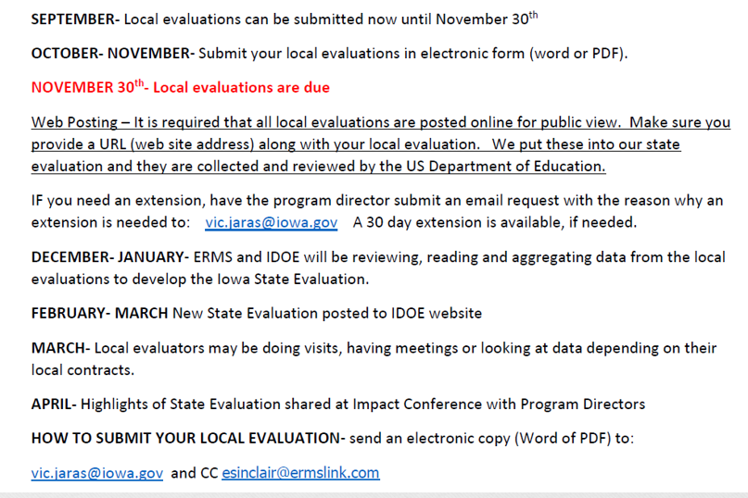

Slide 56
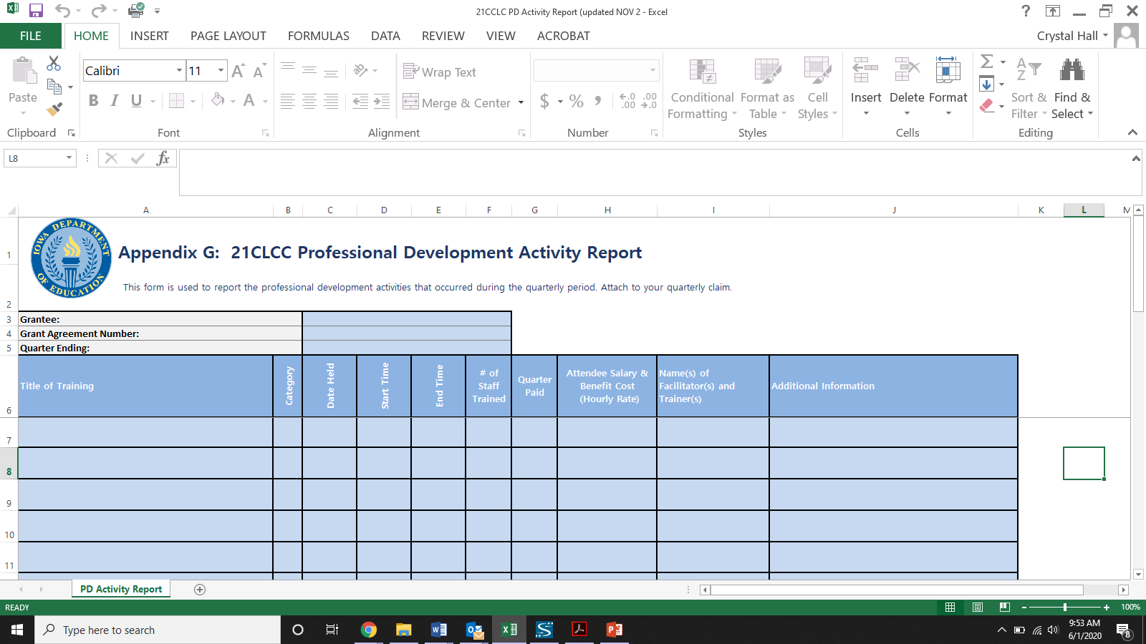

Slide 57
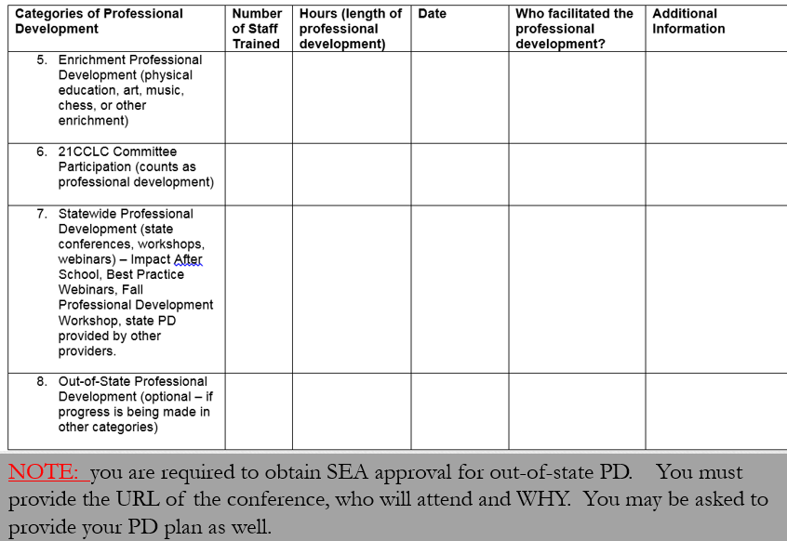

Slide 58
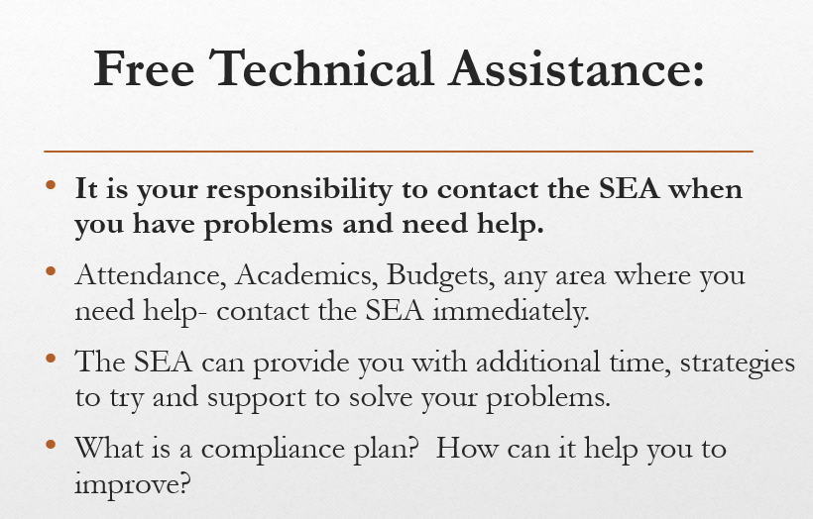

Slide 59
On Site Monitoring Visits:
There is an 11 page monitoring checklist used in the regular DE site visit.
Sites that offer more than 60 hours of contact time per month or more than 30 days of summer school can earn an EXCEEDS on their monitoring report.

Slide 60
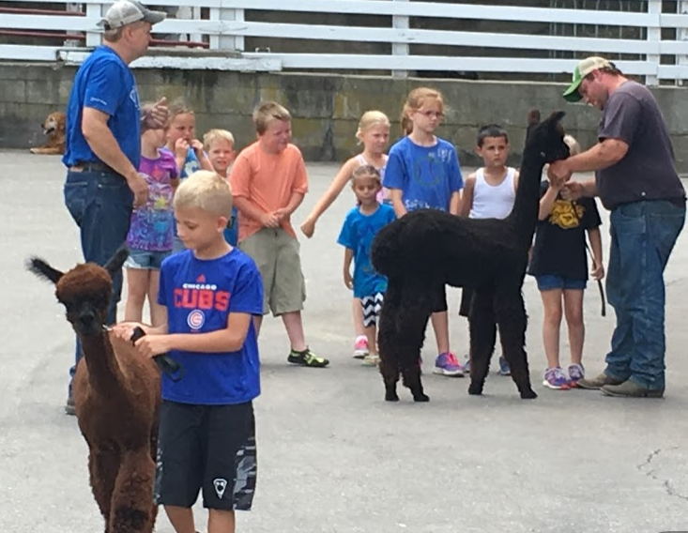
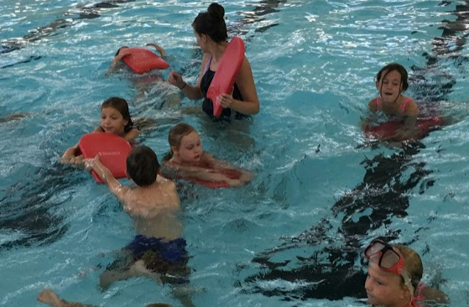
We encourage frequent field trips. They help children learn from experiences.
Field trips provide memories that will last a lifetime.
Guidance- The Importance of Field Trips

Slide 62
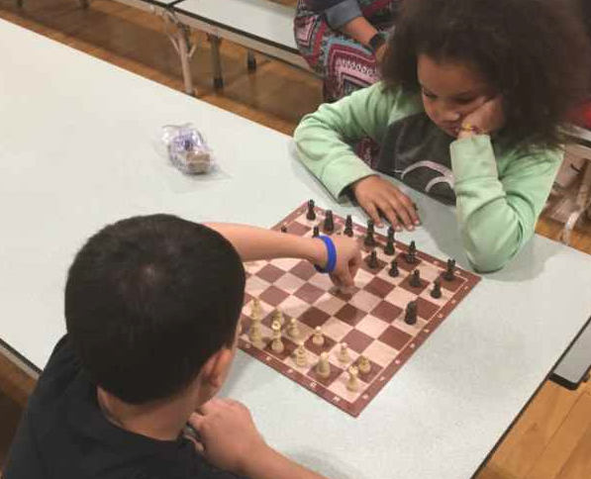
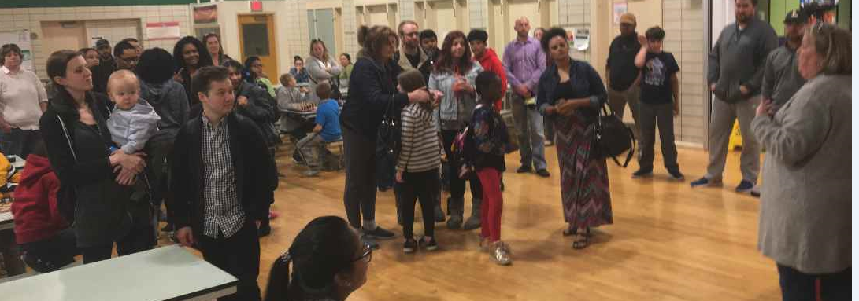
Best Practice Example: Des Moines 2nd Annual Chess Tournament for Elementary 21st Century Students. Over 100 people showed up to watch their children play chess for 2 hours.
This counts as a Family Engagement Activity.
I like that my kids are learning acommon core math standards for probability when they play chess.

Slide 63
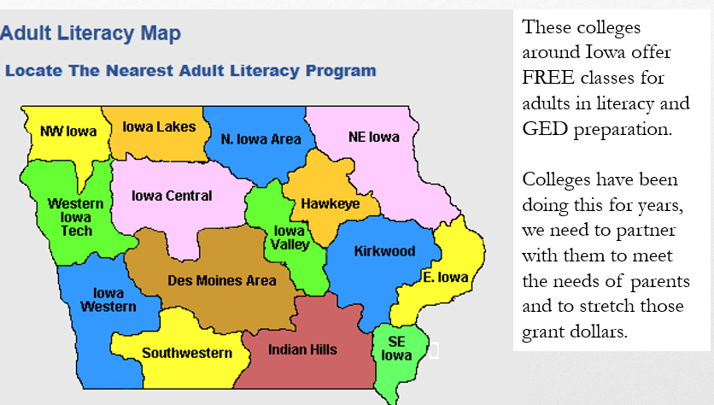

Slide 65
About half of our programs serve kids a full meal afterschool or provide a weekend backpack program.
Hyvee can provide free nutrition education for your program

Slide 66
Statewide partners:
Iowa AG Literacy Foundation- they offer books about agriculture and wind farming plus provide mini grants and a free game http://www.iowaagliteracy.org/resources/publications/publications.aspx
IPTV-Education- They have PBS afterschool content http://www.iptv.org/education and will send a trainer to your site for FREE http://www.iptv.org/education/subject/1069/professional-development
State Library of Iowa (793 libraries that would love to help with literacy)
https://silo.knack.com/directory
Silos and Smokestacks https://www.silosandsmokestacks.org/educate/educator-resources/
Want to see a list of hundreds more partners?
https://www.iowa21cclc.com/21cclc-partners

Slide 67
The Free Game is FARMERS 2050
Available from the APP store or the Play store
You can order a classroom set for .50 cents. They have free lesson plans for teachers

Slide 68
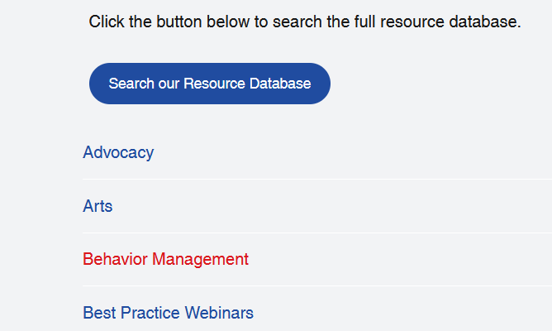
PROFESSIONAL DEVELOPMENT
Visit the Iowa Afterschool Alliance Support Site for Afterschool Programs:
www.iowa21cclc.com
Click on the RESOURCES tab for an entire year of curriculum, lessons and activities for afterschool programs:

Slide 69
We hope that you can get your children excited about learning so that they attend school every day BECAUSE of the Afterschool program.

Slide 70
CHILD CARE CONTRASTED WITH 21st CENTURY
The 21st CCLC program is a federal TITLE program that REQUIRES academic support and with ESSA, academic results. Child Care programs do not have academic requirements.

Slide 71
Two different Programs:
21st Century
Child Care DHS
ACADEMIC REQUIREMENT
FEDERAL TITLE PROGRAM
Competition to apply
9 months for application
Community Partner requirements
Fees discouraged- not best practice –could be banned in the future
Reduction in funds after 3 years because of partners
NO ACADEMIC REQUIREMENT
STATE PROGRAM
Form to apply
Faster application processing
No Community Partner Requirement
Fees Okay
Increase in funds if trainings completed

Slide 72
Questions?
Iowa Afterschool Alliance- Heidi Brown hbrown@sppg.com

