Slide 1
New Awardee Orientation: The Nita M. Lowey 21st Century Community Learning Centers Summer 2024, 2024-2025 School Year
DE CONSULTANT -Vic Jaras
IAA STAFF- Heidi Brown

Slide 2
Introductions- how will your program help kids?
PLEASE SEND VIC AN EMAIL WITH YOUR CELL PHONE NUMBER – VIC.JARAS@IOWA.GOV

Slide 3
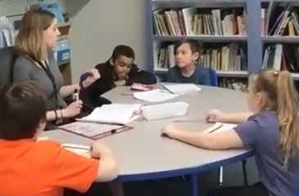
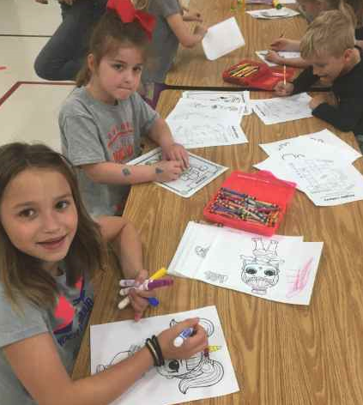
AGENDA
OVERVIEW OF THE PROGRAM
FIRST STEPS
SUPPORT, MONITORING AND ATTENDANCE
PROFESSIONAL DEVELOPMENT
BUDGETS AND FINANCE
DATA AND EVALUATION
QUESTIONS

Slide 4
OVERVIEW OF THE PROGRAM: - How we meet federal requirements - About Iowa's 21st CCLC program - Contract Obligations - child care contrasted with 21cclc - minimum standards for partnerships

Slide 5
Describe how the SEA provides training to subgrantees that support the professional development of program administrators and staff to increase the programs’ capacity, including measures of effectiveness. §4202(c)(3)(B), §4202(c)(3)(D), and §4203(a)(6)
https://www.iowa21cclc.com/professional-development
PD from the Iowa Afterschool Alliance

Slide 6
Describe how the SEA provides training and technical assistance on the local evaluation process to subgrantees. §4202(c)(3)(B), §4202(c)(3)(D), and §4203(a)(6) 4203(a)(6)
The Evaluation committee provides year round support for evaluation
https://www.iowa21cclc.com/evaluation
Our state evaluators provide an annual training for local evaluators and we provide a data collection template for local evaluations. https://educate.iowa.gov/pk-12/essa/guidance-allocations/learning-center-resources
Evaluation Support
Local Evaluation Guidelines
Local Evaluation Form (required for all local evaluations)
Monitoring of Evaluation Guidance
Iowa Local Evaluator Timeline

Slide 7
Describe how the SEA provides training and technical assistance on the subgrantee monitoring process (e.g., desktop monitoring, periodic reports, onsite monitoring reviews, other). §4202(c)(3)(B), §4202(c)(3)(D), and §4203(a)(6)
Desktop monitoring occurs every quarter when claims are submitted, a general ledger and claim spreadsheet are reviewed along with an update on attendance. This is done in our CASA payment system.
Site monitoring occurs in person or virtual and the tools are posted on the IDOE website. https://educate.iowa.gov/pk-12/essa/guidance-allocations/learning-center-resources
Appendix D Iowa Site Monitoring Documentation Form
Appendix E Iowa Comprehensive Site Visit for 21st CCLC

Slide 8
Describe how the SEA provides training and technical assistance on subgrantee fiscal matters (e.g., allowability, drawdowns, carryover, program income, etc.) §4202(c)(3)(B), §4202(c)(3)(D), §4202(c)(3)(H) §4203(a)(6)
We provide training on this in our New Grantee/Staff Turnover committee that meets monthly. Fiscal updates are provided during the monthly Directors meetings. https://www.iowa21cclc.com/new-grantee-and-staff-transition
On the IDOE website, we have a comprehensive Guide to Program Budgets and Accounting, that outlines fiscal procedures, accounting codes, allowability, drawdowns, carryover and program income.
Guide to Program Budgets and Accounting

Slide 9
How does the SEA align any TA/PD efforts with other Federal, State, and local programs? §4202(c)(3)(B), §4202(c)(3)(D), §4202(c)(3)(H), §4202(c)(3)(G)
We work with the Bureau of Food and Nutrition to provide annual training and updates about USDA funding for afterschool programs. https://educate.iowa.gov/pk-12/operation-support/nutrition-programs/afterschool-programs
We encourage districts to combine TITLE IA and TITLE IVB funds to offer an extended summer school program to reduce the summer slide.
We have over 600 community partners (local programs) that allow us to serve more students and provide a higher quality program that with federal funds alone.

Slide 10
OVERVIEW: “The 21st CCLC program provides an opportunity for us to make a difference in the lives of children.”
For those who have not been successful in school, we help kids reconnect to learning in different ways.
We provide academic aid, enrichment activities, social emotional learning, nutritional food, and fun to children who need it most.
You are expected to build a model program of afterschool that will be shared via your data, committee calls, site visits, presentations, web sites and within your community.

Slide 11
The 21st Century Community Learning Centers grant is a federal title program (Title IV B)
ALL Federal Title programs focus on children in poverty and children with achievement gaps.
This program requires a grant competition to distribute funding around the state.
The program requires data reporting in an online system (Annual Performance Report or APR) twice annually starting in 2022 with new GPRA measures that focus on improvement over proficiency.
If you follow the guidance, this program will help you reach your at-risk kids, increase attendance, reduce referrals and improve student achievement.

Slide 12
The purpose of this important program is to create community learning centers that provide academic enrichment opportunities for children, particularly students who attend high-poverty and low-performing schools, to meet State and local student standards in core academic subjects, to offer students a broad array of enrichment activities that can complement their regular academic programs, and to offer literacy and other educational services to the families of participating children. (USDOE guidance)

Slide 13
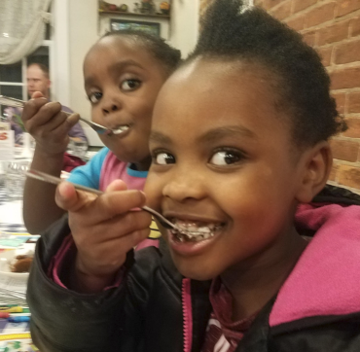
Popular enrichment activities include: Crafts, Cooking, Chess, STEM, Outdoor Activities, and Community Guests.

Slide 14
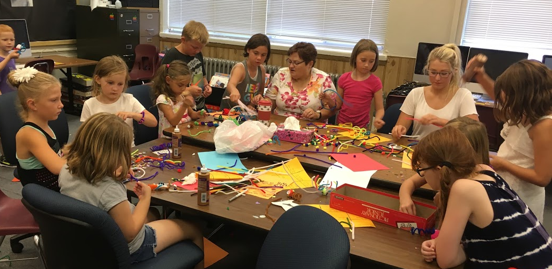

Slide 15
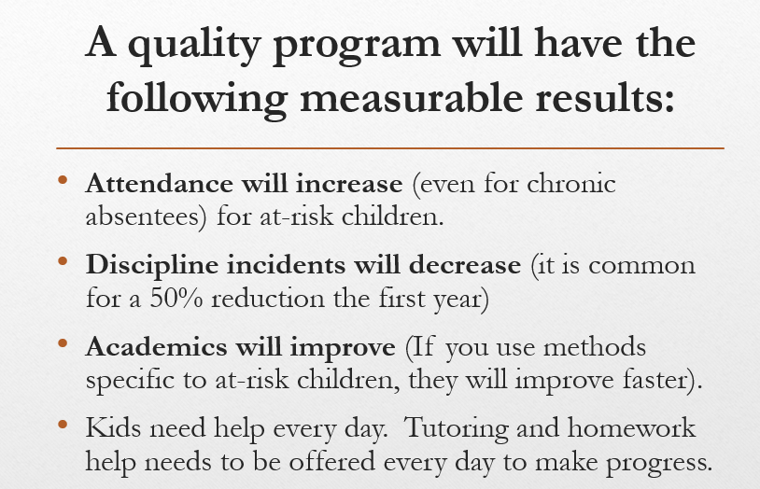
FACT:
Council Bluffs police reported a 50% reduction in youth crime due to the afterschool program! Sioux City police report similar declines.
We are changing lives with these programs!

Slide 16
TIP: Harry Wong has great tips on managing your classroom. Below is the implementation guide.
https://www.effectiveteaching.com/userfiles/uploads/Guides/Implementation_Guide_for_THE_First_Days_of_School_5th_Edition.pdf

Slide 17
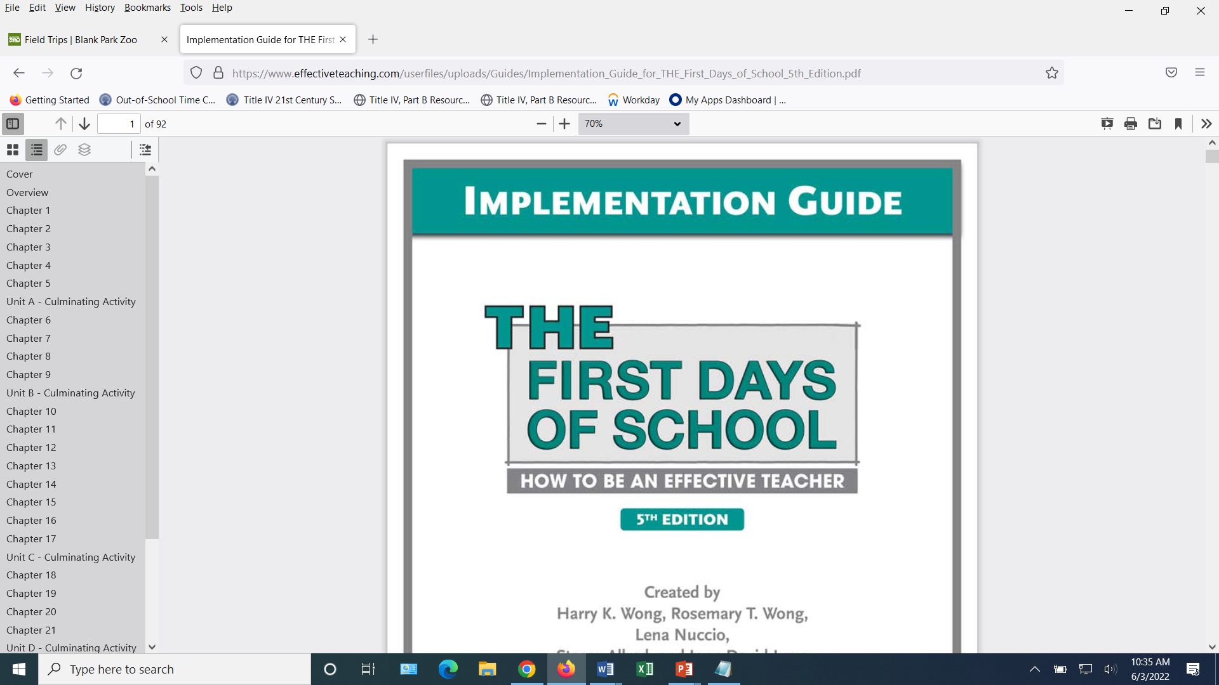
Contract Obligations:
This is on EVERY grant agreement for this program.

Slide 18
Attendance is reported quarterly on the claim spreadsheet

Slide 19
We have code citations for all our required activities

Slide 20
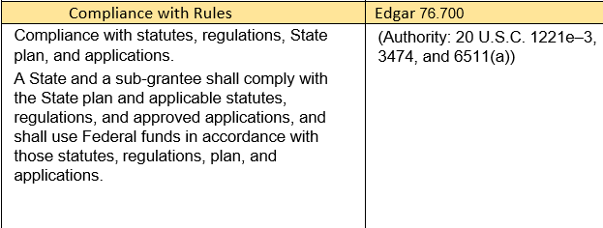

Slide 21
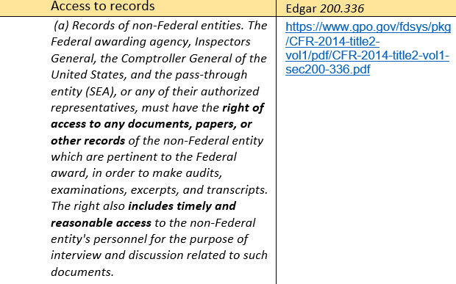

Slide 22
New Claim Spreadsheet
Make sure you are using the new claim spreadsheet –sent with your grant agreement. NEW- Added a section where you can provide additional explanation if needed.
NOTE: One of the common issues with claims is the CASA claim amount MUST match the claim amount on your spreadsheet. It cannot be approved until the amounts match.
Include a Year to Date General Ledger with your Claim Spreadsheet for each quarterly claim.

Slide 23
PLAN THE PROGRAM, HIRE STAFF, BUY SUPPLIES
ENROLL STUDENTS
TAKE ATTENDANCE EVERY DAY
COMMUNICATE ACTIVITIES TO PARENTS
WORK WITH SCHOOL PRINCIPAL AND STAFF TO SUPPORT THE NEEDS OF CHILDREN
HOLD A FAMILY ENGAGEMENT MEETING (MINIMUM OF ONE PER QUARTER)
ENROLL IN A BEST PRACTICE COMMITTEE
ATTEND PROFESSIONAL DEVELOPMENT EVENTS, WEBINARS AND TRAININGS
SUBMIT CLAIMS ON TIME AND WITH DOCUMENTATION
TIP: YOU WILL RECEIVE EMAILS ABOUT THE APR DATA REPORTING BUT YOU WILL NOT DO THIS YOUR FIRST YEAR BECAUSE WE REPORT EVALUATION DATA ONE YEAR BEHIND.

Slide 24
ATTENDANCE REQUIREMENTS:
Report your attendance quarterly on the claim spreadsheet that is uploaded in CASA (our payment system).
You set the attendance in your application (By the end of year one, you should reach 70%)
By the end of year 3, you should reach 80% of the number of children you said you would serve in your application.
Your grant award may be reduced if you fail to meet your attendance goals.
Your grant may not be renewed if you fail to meet your attendance goals.

Slide 25
CHILD CARE CONTRASTED WITH 21st CENTURY
The 21st CCLC program is a federal TITLE program that REQUIRES academic support and with ESSA, academic results. Child Care programs do not have academic requirements.

Slide 26
Two different Programs:
21st Century
Child Care DHS- now HHS
ACADEMIC REQUIREMENT
FEDERAL TITLE PROGRAM
Competition to apply
9 months for application
Community Partner requirements
Fees discouraged- not best practice –could be banned in the future
Reduction in funds after 3 years because of partners
NO ACADEMIC REQUIREMENT
STATE PROGRAM
Form to apply
Faster application processing
No Community Partner Requirement
Fees Okay
Increase in funds if trainings completed

Slide 27
Sustainability FOR YOUR PROGRAM
HHS Child care funding can be used along with 21st CCLC grant funding to provide services. These funds supplement each other.
When you attend the annual Impact Afterschool Conference, you can earn HHS childcare education credits- which can increase your childcare funding over time
HHS has additional rules (mostly focused on the safety of children)
Charging fees is not a best practice, but being a licensed child care center is a best practice.

Slide 28
FIRST STEPS:
21CCLC Grantee Timeline and Yearly Activities
Family Engagement Guide
Websites – where to find things
https://educate.iowa.gov/pk-12/essa/guidance-allocations#general-essa-guidance-and-resources
https://www.iowa21cclc.com

Slide 29
FIRST STEPS:
1. Enroll children in your program
2. Recruit teachers and community groups to provide engaging enrichment
3. Buy supplies and snacks
4. Have a Parent Engagement Meeting (every quarter)
5. Have a budget planning meeting
6. Monitor how your program is operating- if you need help- contact Vic
7. The Iowa Afterschool Alliance will do a Best Practice site visit your first year and help you with PD, partnerships and resources to help you succeed.

Slide 30
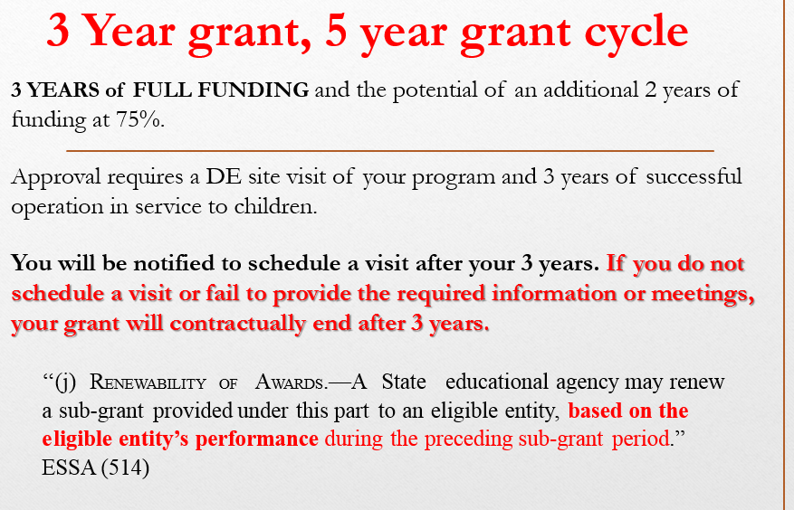
START YOUR PROGRAM
Focus on the needs of children - More programs providing full meals
Developing partnerships (Community Colleges, 4H, United Way, Nutrition, Physical Education, and More) - over 700 partners across the state
Gathering Your data–Data helps validate our good work
Improving our evaluation (R&R Educational Consulting) - Collects data for state evaluation-training for local evaluators. Local evaluations are posted on your web site.
Committees to share and improve our work - A community of practice
Reading is our Priority along with Math - We report this data to Congress via the APR online data system.

Slide 31
Family engagement: 4 meetings a year (min)
Inform families about the program –showcase some activities each meeting
Recognize the achievements of children (attendance, behavior and academics)
Partner with a Community College to support Adult Literacy (a required partnership)
Partner with a local restaurant to provide food at this meeting
Do a cultural potluck to share different foods and learn about each other
Ask parents to volunteer on field trips or a Saturday event
SEE THE GUIDE TO FAMILY ENGAGEMENT https://www.iowa21cclc.com/_files/ugd/1b1b6d_9fad8eff609149ac8ba966d4579f7b54.pdf

Slide 32
Partnerships: Minimum standards 5 Partners to apply for grant
You should be increasing your partnerships by 1 new partner per year (minimum)
So at a minimum, you should have 10 community partners by year 5 of your grant for EACH COHORT.
All of our rural sites have more than met this minimum standard and our urban areas should have no trouble exceeding this minimum.
Partner with a Community College to support Adult Literacy (a required partnership)
Partner with a local restaurant to provide food at meetings

Slide 33
Websites TO BOOKMARK:
Let’s take a minute to show you the websites and where things are generally located.
Need assistance?
https://educate.iowa.gov/pk-12/essa/guidance-allocations/learning-center-resources
https://www.iowa21cclc.com

Slide 34
SUPPORT, MONITORING AND ATTENDANCE
Guidance on Attendance
Engaging activities
Site Visits
Grant Monitoring
The Importance of Field Trips
Community Partnerships

Slide 35
Why support, monitoring, and attendance is importance
In Iowa, we do things a bit different from other states. We have:
More Community Partners than any other state (over 640)
Excellent Reading average- 65%
Good Attendance – 82%
About half our sites feed children a full meal- some states do not allow food
Excellent Support- Online Resources, Face to Face Meetings, Committees, Site Visits and Technical Assistance Meetings.

Slide 36
Guidance on ATTENDANCE
Iowa ranks first in the nation in the percent of children under 6 years of age with all parents in the labor force (75.6 percent) - U.S. Census Bureau
“Improving attendance is an essential strategy for reducing achievement gaps. State and national data shows that students from low-income families are more likely to be chronically absent than their peers (Ginsburg, Jordan, Chang, 2014).”
If you do not meet your grant attendance goals, your funding will be reduced the following year in your annual grant.

Slide 37
ATTENDANCE REQUIREMENTS:
You will report your attendance each quarter on your claim form- The number enrolled, and the average daily attendance for the quarter.
On your application your attendance goals should be monitored.
After year one, you should have met 70% of your attendance goal.
After year three, you should have met 80% of your attendance goal.
Attendance is reported in the online APR data system twice annually.
If you do not meet the attendance goal you set- your funding may be reduced the following year.

Slide 38
Family ENGAGEMENT Requirements
You should have a MINIMUM of 1 Family Engagement meeting each quarter. That is 4 meetings per year (unless you are a summer only program).
We have a guide to Family Engagement available online:
Access the Family Engagement Guide Here
We have a Family Engagement Community of Practice that you can join or simply attend a meeting to get answers to your questions.
https://www.iowa21cclc.com/family-engagement

Slide 39
Iowa was the first state in the nation to provide guidance for serving children with disabilities.
Iowa 21 CCLC and Children with Disabilities Guidance - Explains the responsibilities for providing children with disabilities with an equal opportunity for participation in 21st Century Community Learning Centers programming and other before-school and after-school programs operated by school districts.

Slide 40
Federal Guidance from the US Department of Education –
National Technical Assistance Center
https://21stcclcntac.org/index.html
Eleven implementation guides focus on helping programs build capacity to meet the needs of all students, including students with disabilities. Experts, advocates, and 21CCLC practitioners and program leaders contributed their knowledge and experience to support your efforts to create and sustain high-quality inclusive programs.
Guides available on the website: www.iowa21cclc.com
These guides will be available on the iowa21cclc.com website

Slide 41
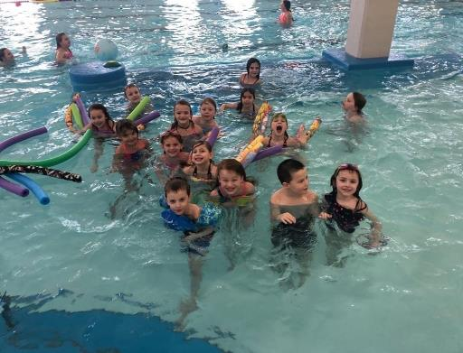
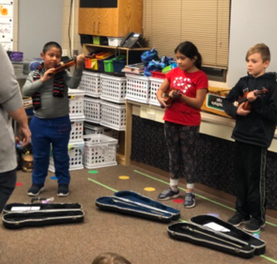
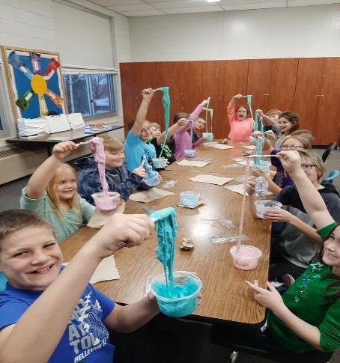
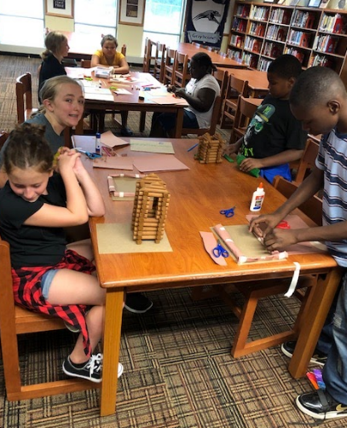
Engaging activities

Slide 43
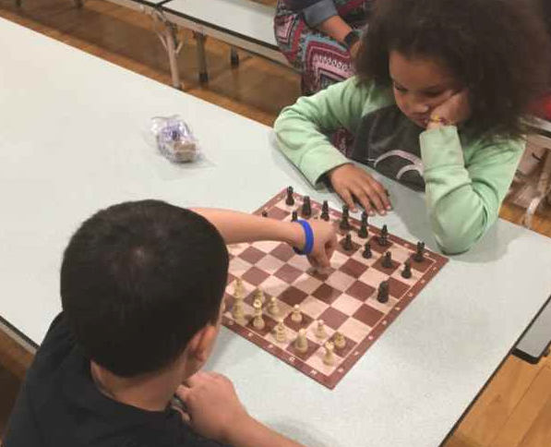
Best Practice Example: Des Moines 2nd Annual Chess Tournament for Elementary 21st Century Students. Over 100 people showed up to watch their children play chess for 2 hours.
This counts as a Family Engagement Activity.
I like that my kids are learning a common core math standards for probability when they play chess.

Slide 44
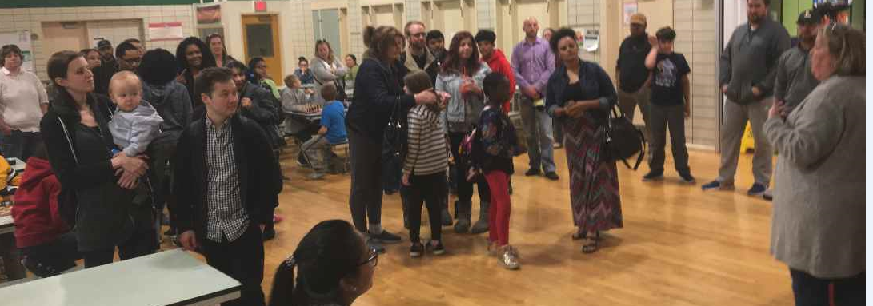
About half of our programs serve kids a full meal afterschool or provide a weekend backpack program.
Hyvee can provide free nutrition education for your program

Slide 45
Food is an important part of these young people’s lives!
March 23, best Practice webinar recording: https://www.youtube.com/watch?v=ts0L1UYssIM
Website: https://educateiowa.gov/pk-12/nutrition-programs/
Did you know that you can receive 5 BONUS points on your application if you serve children a full meal in partnership with a local food bank or your school food service using special afterschool funding from the USDA?

Slide 46
Support & Monitoring: Site visits
We have three different ways to support and monitor programs.
First the IAA will help new grantees with your Professional Development needs and answer startup questions.
Second, The DE Site Visit. There is an 11 page monitoring checklist used and posted online. This will be sent to you via email before a site visit.
Third, the DE Comprehensive Site Visit- after 3 years, to determine if you qualify for an additional 2 years of funding.
Note: Some DE site visits may be virtual via ZOOM.

Slide 47
IAA Best Practice Contacts
Designed to help sites identify best practices and activities to improve their program and prepare sites for their official IDOE site visit.
Numbers: students, staff, volunteers
Site goals
Partners
Best practices currently in place
Plan for professional development
Support needed
Next steps/TA

Slide 48
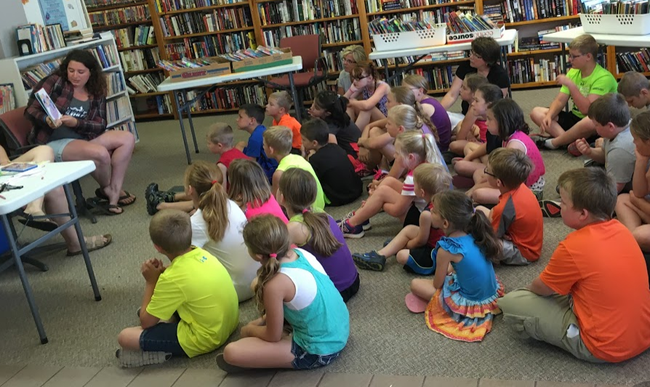
Reading aloud to the children-meeting Iowa Core Standards which is a BEST PRACTICE
VIC TIP- Weather permitting, you could do a read aloud outside

Slide 49
On Site Monitoring Visits:
There is an 11 page monitoring checklist used in the regular DE site visit. This is Appendix D in the RFA.
Sites that offer more than 60 hours of contact time per month or more than 30 days of summer school can earn an EXCEEDS on their monitoring report.

Slide 50
The snack today was much better than we usually get.
Talking with the children on a site visit provides un-scripted information about the program.
I ask them: “Do you like the program?”
What was your favorite activity?
Are you making new friends?

Slide 51
Iowa was approved by the US DOE to do Risk Assessment and Monitoring as part of our regular operations.
Other states require an annual risk assessment and monitoring report to be submitted by grantees.

Slide 52
How to reduce the “anxiety” of State Monitoring:
Understand that our priority is the help the grantee be successful in serving children
Many of the Site Visit requirements were embedded in the application
ALL the site visit documents are posted on the IDOE website – You have months to review them and ask questions via email or phone
You will receive reminder emails- it is a good idea to read them
Follow the guidance- and your program will succeed
What? Of course I don’t have the Sustainability Plan ready yet. I know I had 3 years to work on it.

Slide 53
SEA Requirements: What the state must do:
II.2 Does the SEA conduct regular, systematic reviews of subgrantees to monitor for compliance with federal statutes and regulations, applicable state rules and policies?
4202(C)(3)(A)
EDGAR §76.770
UGG §200.328(a)
UGG §200.331(b)(d)
Federal Statutes that requires us to monitor your program

Slide 54
TWO EXAMPLES FROM IOWA

Slide 56
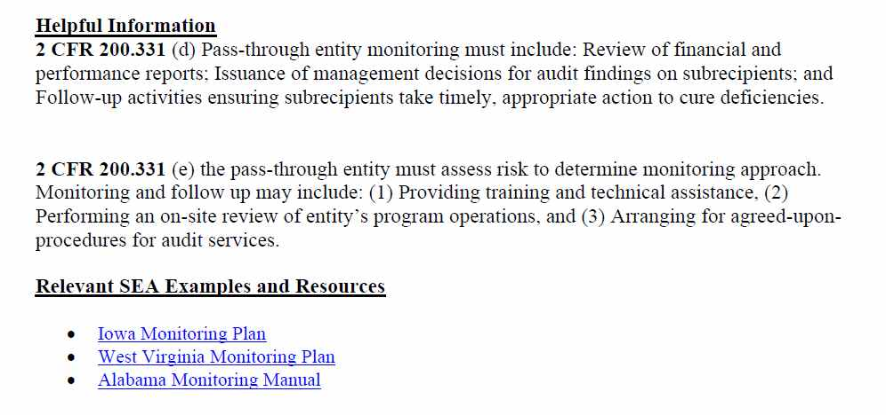

Slide 57
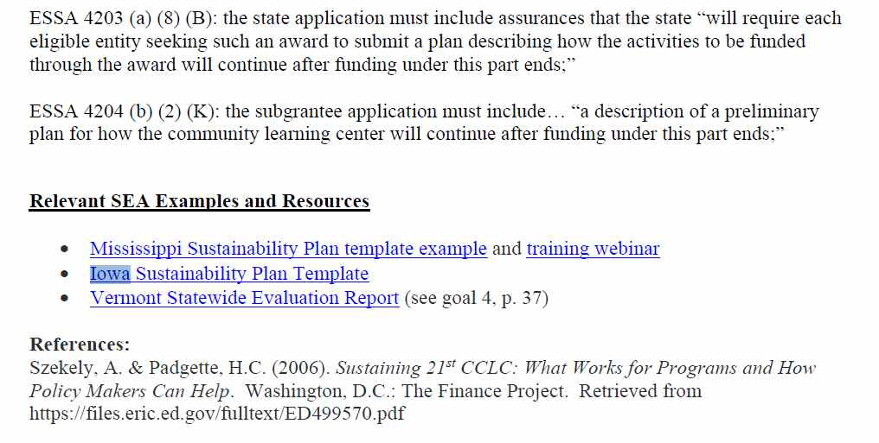

Slide 58
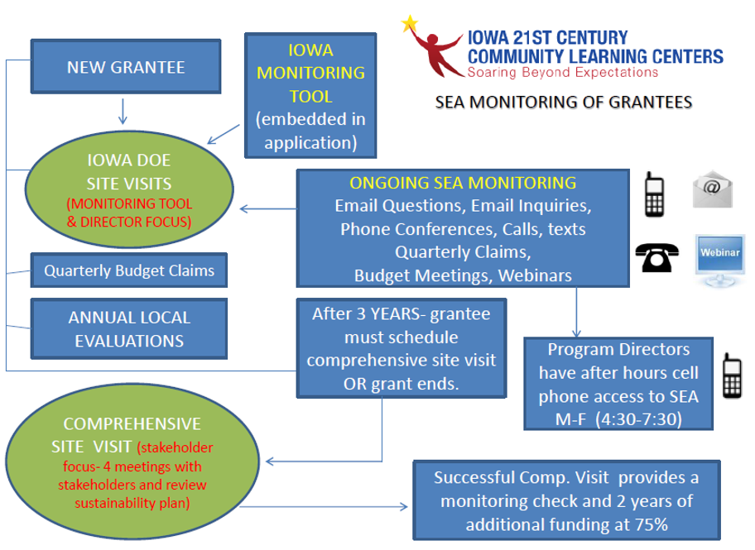
The Importance of Field Trips - Guide Available here: https://www.iowa21cclc.com/grant-info

Slide 59
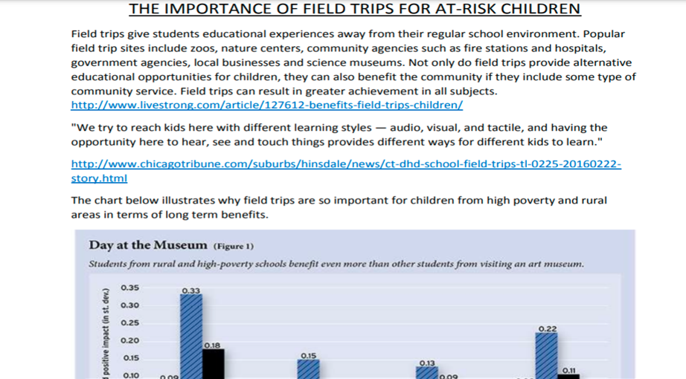
Kids love to go outside and learn about nature
Partner with the Iowa Dept. of Natural Resources
https://www.iowadnr.gov/Conservation/For-Teachers/Classroom-Resources

Slide 60
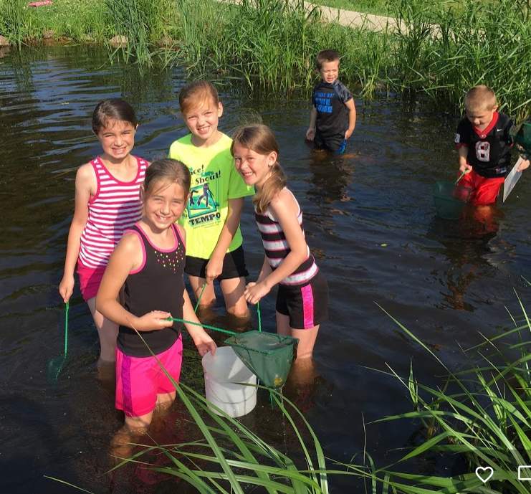
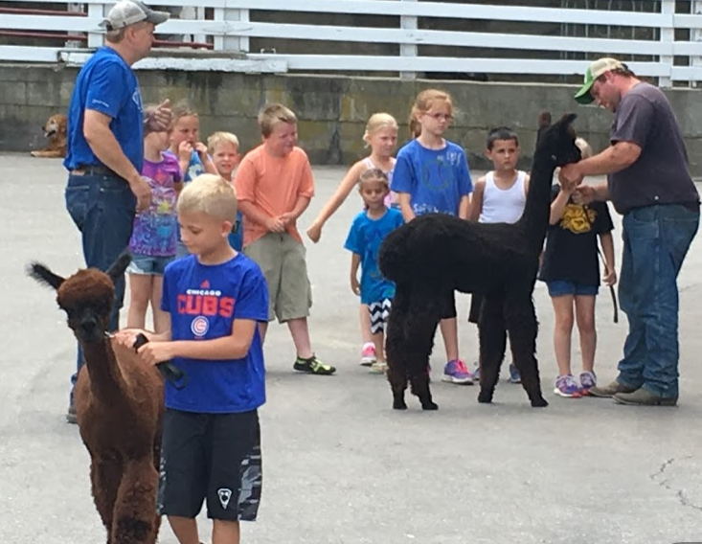
We encourage frequent field trips. They help children learn from experiences.
Field trips provide memories that will last a lifetime.
Guidance- The Importance of Field Trips

Slide 61
Community College Partners
Community Colleges receive federal dollars to provide Adult Literacy education. They are happy to partner with you.
Adult Literacy –HiSET Preparation
College Volunteers to work in your program
Pre Service Teachers to work in your program
Field Trips to the College to learn about programs they offer

Slide 62
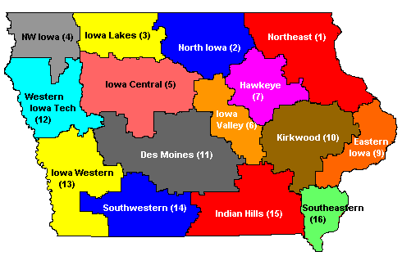
Adult Literacy Classes
These colleges around Iowa offer adult literacy support and access to HiSET (high school completion)
Colleges have been doing this for years and we agree to partner with them to meet the needs of the parents and families associated with our programs. This helps to stretch our grant dollars.

Slide 63
Statewide partners:
Iowa AG Literacy Foundation they offer books about agriculture and wind farming plus provide mini grants and a free game http://www.iowaagliteracy.org/resources/publications/publications.aspx
IPTV-Education They have PBS afterschool content http://www.iptv.org/education and will send a trainer to your site for FREE http://www.iptv.org/education/subject/1069/professional-development
State Library of Iowa (793 libraries that would love to help with literacy) https://silo.knack.com/directory
Silos and Smokestacks https://www.silosandsmokestacks.org/educate/educator-resources/
Want to see a list of hundreds more partners? https://www.iowa21cclc.com/21cclc-partners

Slide 64
The Free Game is FARMERS 2050
Available from the APP store or the Play store
You can order a classroom set for .50 cents.
They have free lesson plans for teachers.

Slide 65
Professional development
New Grantee Orientation
Impact Afterschool Conference
Spring and Summer Workshops
Best Practice Webinars
Committees (New Grants must participate in monthly New Grantee and Staff Transition meetings)
Other meetings as required
Technical Assistance as needed

Slide 66
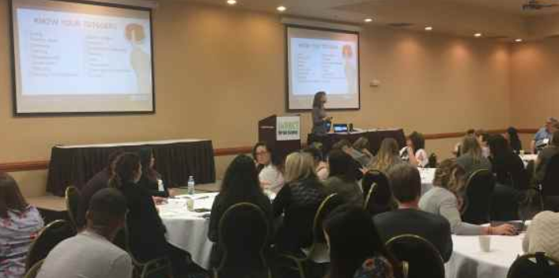
PROFESSIONAL DEVELOPMENT:
EVERY YEAR WE PROVIDE:
NEW AWARDEE ORIENTATION – you are on this call right now ☺
STATE CONFERENCE - Attendance is required for all
SEASONAL WORKSHOPS: (select one)
SPRING
SUMMER
BEST PRACTICE WEBINARS
COMMITTEES (one per cohort required)
Technical Assistance Meetings for the grant application.
Other meetings as needed

Slide 67
Impact afterschool conference, seasonal workshops, and Webinars
Impact conference has been changed to fall
Seasonal workshops – Spring and Summer
Best Practice Webinars – One per quarter at 10:00am held via Zoom.
Recordings can be found here: https://www.iowa21cclc.com/best-practice-webinars

Slide 68
COMMITTEES: A Community of practice
We have five* committees- you are required to participate in one of the five committees for each cohort your are funded in.
COMMUNICATIONS, PARTNERSHIPS AND SUSTAINABILITY- Plan outreach to the community, recruiting partners and long term sustainability.
EVALUATION – Plan surveys, Evaluation and APR work
FAMILY ENGAGEMENT -Plan quarterly Family Engagement outreach
PROFESSIONAL DEVELOPMENT-plan annual conference and other PD
*NEW GRANTEE-STAFF TRANSITION (required for ALL brand new grantees and for new staff –Directors and Coordinators)
www.iowa21cclc.com/committees

Slide 69
New Grantee / staff Transition
This committee meets monthly and is designed to provide additional support in the operation of the program.
IF YOU HAVE STAFF TURNOVER- YOU MUST ENROLL THE NEW STAFF IN THIS COMMITTEE
IF YOU HAVE STAFF TURNOVER- YOU MUST NOTIFY THE IOWA DEPT. OF EDUCATION VIA EMAIL WITH THE NEW STAFF NAMES, POSITION, CONTACT INFORMATION.
According to statute a significant staff turnover elevates your RISK STATUS. Contact Vic ASAP when you have any staff turnover (director, finance, coordinators but not normal support and teaching staff). The IDOE will determine the need for additional risk monitoring based upon the information you provide.
We have a guidance sheet for this requirement.

Slide 70
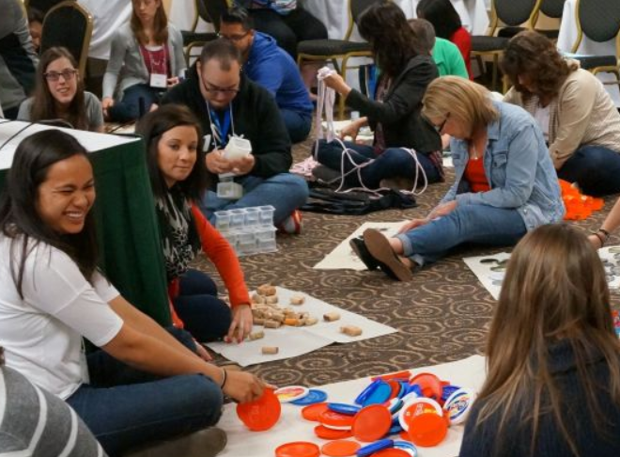

Slide 71
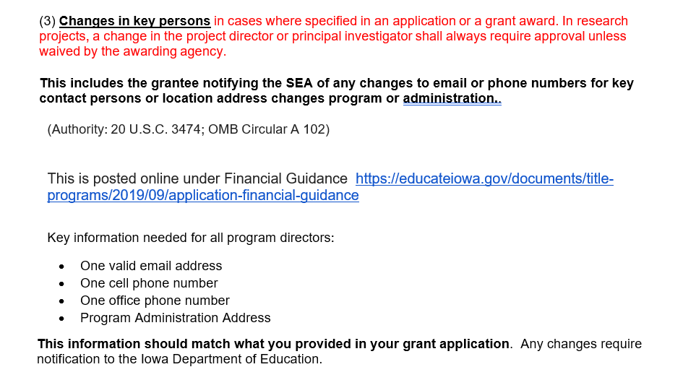

Slide 72
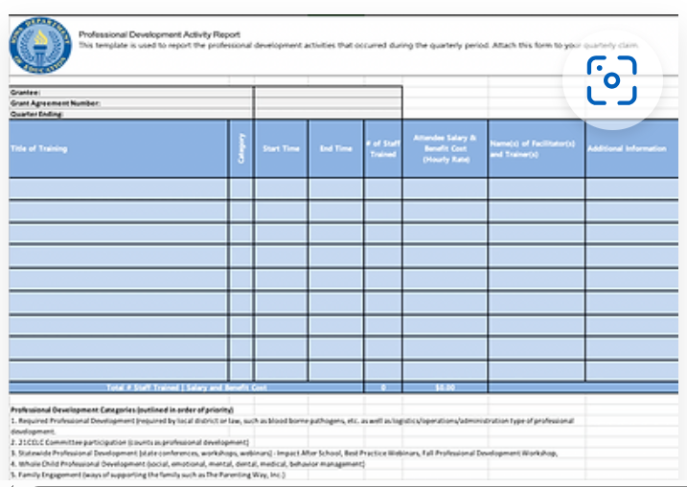

Slide 73
BUDGETS AND FINANCE
Guide to Program Budgets and DE guidance on Finance
Please give a copy of these documents to your finance person.
Guide to Program Budgets and Accounting

Slide 74
DATA AND Evaluation:
Statewide Evaluation and Annual Survey
Reporting Your Data in the APR system
60 hours Contact time and the achievement gap

Slide 75
Evaluation:
You will participate in 2 evaluations each year.
First, is your local evaluation – Due November 30th
The second is your state evaluation.
We read all 1,200 pages of local evaluations and may ask for clarification on data or request missing data that is required. Data is summarized and aggregated into the annual Iowa State Evaluation. This is sent to the USDOE.
While your first local evaluation is one year behind.
You will need to report your Summer School data in the first APR window-online data system.
Since we report local evaluation data one year behind, your local evaluator has plenty of time to gather the data, meet with you and develop your evaluation.
We even provide a data gathering template for your local evaluator to make their task easier.
We provide training for your local evaluator on what data is required for the state evaluation.

Slide 76
SEA Requirements:
II.12 Does the state conduct a comprehensive evaluation (directly, or through a grant or contract) to monitor the effectiveness of 21st CCLC programs, and progress towards the performance indicators and performance measures used to evaluate subgrantees? §4202(C) (3)(A) §4203(a)(6)
§4203(a)(13) §4205(b)(2)(A)
II.13 Does the state have clearly defined and appropriate performance indicators and performance measures used to evaluate programs? Does the state measure GPRA indicators? §4203(a)(13)(A) §4205(b)(1)(B)
II.14 Does the SEA notify and make program evaluations available to the public? §4203(a)(13)(B) §4205(b)(2)(B)(ii)

Slide 77
https://educate.iowa.gov/pk-12/essa/guidance-allocations/learning-center-resources

Slide 78
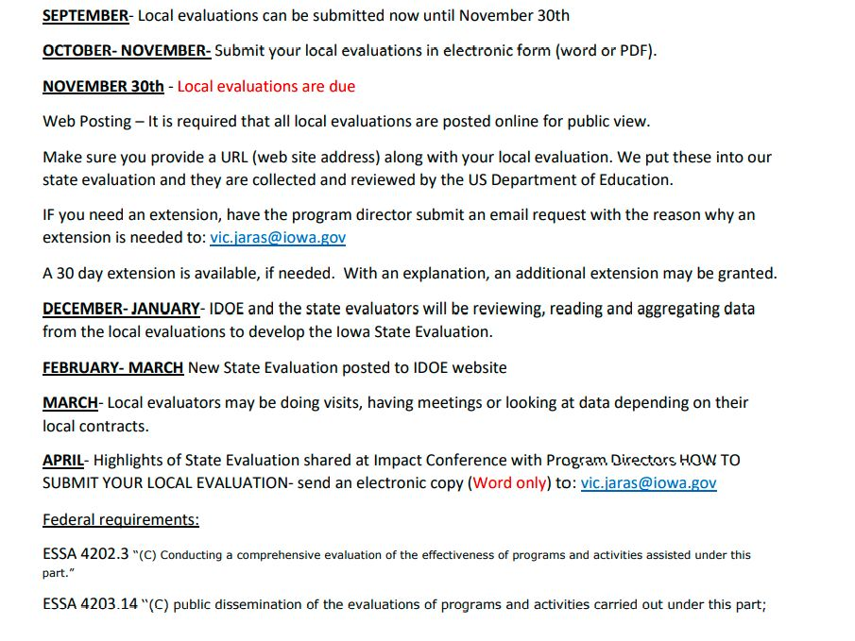
State Evaluation- July (sent to Directors and posted on IDOE website)

Slide 79
ANNUAL SURVEY
Done via Survey Monkey
Sent as a PDF for you to review before you enter the data
This collects data not available in the Annual Performance Report (APR)
Contents of this survey appear in the State Evaluation

Slide 81
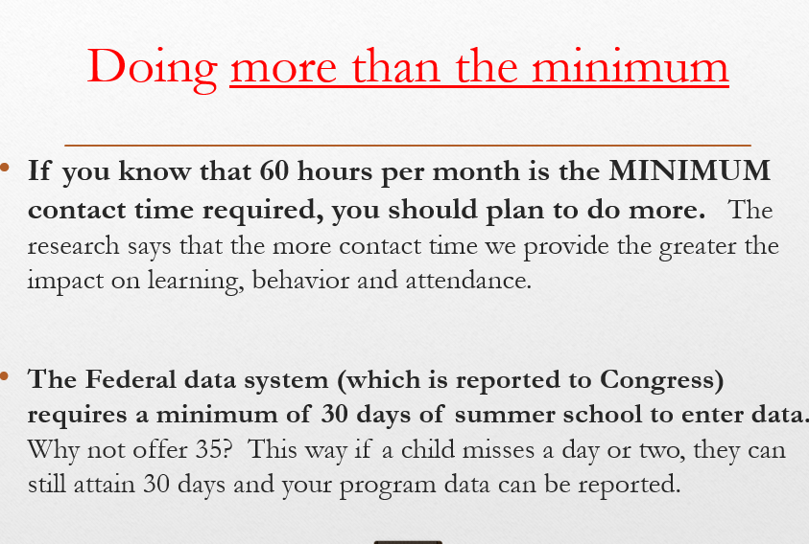
We hope that you can get your children excited about learning so that they attend school every day BECAUSE of the afterschool program.

Slide 82
Questions?
Vic’s CELL PHONE- 515-402-2729

